Slide 1






WELCOME!
CAREER TRANSITION READINESS PROGRAMME
5 MODULES IN 5 DAYS

Slide 2



Zoom - Housekeeping rules
You are muted by default. The chat function is disabled.​
Expect to participate dropping words and questions in the chat function. ​
If you have any questions, please submit them through Zoom Q&A button.​
The session will be recorded. The recording and presentation will be available on: Career Transition Series webpage.
Notes:
This session is a bit different than others because we will have an open chat. The team has kindly agreed to make an exception for us today so we may engage a bit throughout the next 90 minutes. .
Please hold questions until the end, we will allow for time to address them, in the end ok?

Slide 3

Teresa Callejo
Career Strategy & Development
10+ years helping global professionals gain clarity & confidence:
Navigating growth in transitions
Translating UN experience into market value
Notes:
Thank you for the kind introduction, and thank you for having me. My name is Teresa Callejo.
I'm an HR professional with a background in Talent Acquisition, Headhunting and Professional Development.
I spent over 10 years working with international professional from around the world. 1. Helping them understand the market, 2. explore different career paths and 3. ultimately find their place in the private sector. So over these five days I'm hoping to lend you my recruiter glasses a little bit: to help you understand how the private sector thinks, how hiring works, where your experience might fit, and how you can start navigating that transition.
And we'll do this very practically, we are not asking you to spend seven and a half hours just listening to me. We are going to give you time to work on your own transition as we go.

Slide 4
CAREER TRANSITION READINESS PROGRAMME
DAY 1. MAPPING THE PRIVATE SECTOR
DAY 2. DESIGN THINKING YOUR CAREER
DAY 3. JOB SEARCH STRATEGY
DAY 4. APPLICATION MATERIALS
DAY 5. COMPENSATION
5 DAYS INDEPENDENT CONTENT /1,5 HOURS PER DAY
7,5 HOURS YOU INVEST IN YOUR TRANSITION
1 TAKE AWAY WORKBOOK + RECORDINGS
Notes:
We are aware that this programme is a significant investment of your time, and we do not take it lightly. The sessions are 1 hour and a half every day for five days. They are independent, so if you have to miss session you are most welcome on the next ones.
Today we're going to look at the private sector: look at the different environments, how they work and where your experience might fit.
Tomorrow we'll use Design Thinking to explore possible directions. On Wednesday, which is Day 3, we'll turn that exploration into an actionable job search strategy. Thursday, Day 4 is about how you position yourself through your application materials, your CV and your LinkedIn. And on Day 5, we'll look at compensation and salaries in the private sector.
There is a logic to the sequence, but don't worry if you have to miss a session. Like I said, the sessions stand on their own. You will want to review the recordings when we make them available and you have a Workbook.

Slide 5
CAREER TRANSITION WORKBOOK
LEARN → REFLECT → CONTINUE
Follow the concepts, examples and tools we cover each day.
We will make time for selected Reflection exercises during the sessions.
CONTINUE YOUR JOURNEY
Take the learning beyond the sessions: explore, experiment, talk to people and test what you are learning in the market.
ROADMAP & COACHING SUPPORT
Step-by-step guidance and making the most of coaching support, should you have access to it.
Notes:
The workbook is a complement of the sessions and a practical takeaway of the whole journey. It has content, practical exercises, and post-work.
Learn is an abridged version of the content,
Reflect are the practical exercises for each day, this is where I want you to stop and apply what we're discussing to your own transition. We will make time each day to complete the Reflection exercises,
Continue Your Journey are practical actions you can do between sessions or after the programme.
As additional post-work, there are 2 additional tools: a Career Transition Roadmap to takes you step-by-step in your transition process. And if at any point you work with a coach, know that this program is perfectly compatible with it and so we´ve included a small checklist to help you work with coaching professionals, whether they be external or UN.
The workbook is yours to keep and come back to.
Let´s take a couple minutes to go over it, shall we?
.

Slide 6
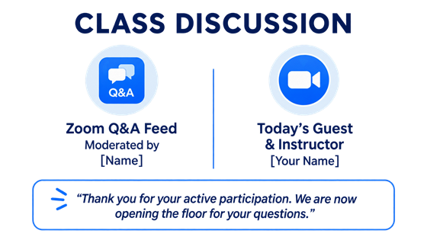
WORKBOOK_ GUIDED TOUR
1. Download and open the workbook_ 1 minute perusal
2. Go to the Contents page (page 2)
4. Find the practical exercises or REFLECTIONS in each Module
1. Page 6
2. Pages 9 & 13
3. Page 15
4. Page 16
5. Page 19
If you have to miss a session you can make it up with the Workbook
Notes:
Please download the workbook and open it. I'll give you a moment. You can scroll through a few pages and get a feel for how it's organized.
ALLOW 1 MINUTE
May I have your attention please. Go to PAGE 2 to the Contents page. You should recognize the five modules.
Now please find the practical exercises for each module, they are called REFLECTIONS. We will do this every day, find the reflection or exercise for the day in the workbook and give you time at the end of the session to do it.
I you miss a session you can make it up in the workbook and come the following day, no harm done.
Go to page 6, to find the Reflection for Module 1. That's the Reflection we'll use later today.
Go to pages 9 and 13, and you´ll see the exercises for Module 2
Go to page 15 to see the exercises for Module 3, and so on.
Without further ado, let´s jump into today´s session
You will have noticed that throughout the workbook there is a rhythm: Learn, Reflect, Continue.
Let me explain very quickly what that means.

Slide 7
CAREER TRANSITION READINESS PROGRAMME
DAY 1. MAPPING THE PRIVATE SECTOR
DAY 2. DESIGN THINKING YOUR CAREER
DAY 3. JOB SEARCH STRATEGY
DAY 4. APPLICATION MATERIALS
DAY 5. COMPENSATION

Slide 8
DAY 1 AGENDA: Mapping the Private Sector
Fit Framework
Sector Deep Dive
    Tech, Consulting, Industry, Consumer, Pharma, Finance, and Social Impact
Workbook Reflection_Module 1
Notes:
This is the agenda for Mapping the Private Sector. We´ll look at how you might fit in the private sector taking into account different variables, we are going to deep dive into each of the categories that comprise the private sector and finally I will give you time to work on today´s REFLECTION so you can input your findings in the workbook

Slide 9
QUESTION FOR YOU
Where are you connecting from today?
From which country or city
Or which Agency?
Share in the chat.
Notes:
Let´s start with a practice question please, Where are you connecting from today? It can be your physical location or your professional location in the UN if that feels more relevant.
I am seeing…… I myself am connect from Europe, in my apartment in Madrid, Spain.

Slide 10
QUESTION FOR YOU
What is your energy level today?
Chose one number:
Share your number in the chat.
5- Very high
4- Ok
3- So-so
2- Not so good
1- I need coffee ASAP
Notes:
Second practice question. What is you energy level today? Pick a number from 1 to 5, 5 being the highest of energies and 1 being the lowest level.
If I see a lot of 1s I might just send you out for coffee…

Slide 11
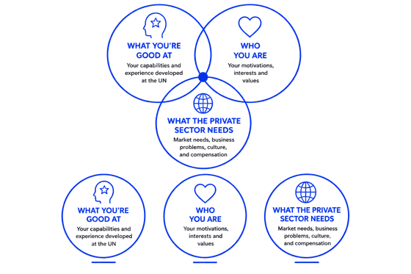
The Framework
1
2
3
Notes:
When thinking about one´s career this is often one of the most popular frameworks. Perhaps you are familiar with this venn diagram, or the popular Ikigai model, that shows the different aspects of a balanced career choice, I find it´s a good and simple starting point to speak about career transition. There are 3 circles: 1. what you are good at already. 2. What motivates you and the kind of work you actually enjoy. 3. And third, what the world or in this case the private market needs. The spot in the middle is called the intersection or sweet spot. As a career choice, the intersection would be a mix of these 3 elements.
This last circle, “what the private sector needs” is the main thing I want to show you today. The knowledge of how the private sector is organized. And the aim is to frame it in a way that you can easily see how this piece of the puzzle or venn diagram overlaps with the other two. How it might intersect with “what you are good at” and “who you are”, so today you walk out with real career options in the private sector.

Slide 12
1. What You are Good At
Most UN careers repeatedly build
five major capabilities:
Complex coordination
Operating under uncertainty
Regulatory and political navigation
Large-scale operational management
Stakeholder trust
Notes:
Inside the UN, you might feel like you are completely “normal”, but outside the UN, for anybody really looking in, you have, what others would call, superpowers, ok, I call them superpowers, and you can also call them capabilities.
What you see on screen are some of the strongest transferable capabilities professionals build in the UN: complex coordination, operating under uncertainty, regulatory & political navigation, large-scale operations, and stakeholder trust.
There are many more, obviously, as each area and role in the UN brings its own set of capabilities, but most UN careers repeatedly build combinations of these major ones. What makes them particularly valuable is that they are difficult to build, they are scarce in the market, and are increasingly important in the private sector globally.
If you would like to know more we have a Career Transition Session on this subject, the link is available in the workbook for you to view on your time.
Today I merely want to point you towards capabilities as a solid entry point into the private sector, as they are highly valuable when framed and translated in a language the market understands.

Slide 13
2. Who You Are
Think about:
Your interests and motivations
Professional culture where you thrive
Your own capabilities
Compensation that fits you
Notes:
Who you are is key because a successful transition requires a fit for you in different areas, not just in capabilities.
Who You Are, your interests, your capabilities, the culture that might suit you and the compensation that you need, might be a bit difficult to assess if you are not familiar with the private sector. Two professionals with very similar profiles may thrive in completely different environments depending on how they work, what motivates them, and what type of culture brings out their best performance in them.
As we go through each piece of the private sector today, I’d like you look at them through this lens. 1. Motivation asks whether the sector aligns with what energizes you. 2. Culture fit looks at where you are likely to feel comfortable and perform well in that environment. 3. Capability fit asks whether your experience and strengths translate naturally into the sector. 4. Finally, compensation fit is a critical and often sensitive dimension. Compensation expectations, family responsibilities, lifestyle, can significantly shape which sectors are realistic options.

Slide 14
3. What the Private Sector Needs
We call it “private sector” but it´s not one sector… it´s many!
Tech
Consulting
Industry
Consumer
Pharma
Finance
Social Impact
Notes:
Ok, so this is interesting for us to address today, what professionals in UN usually call “the private sector” is actually not 1 sector, but a set of SECTORS plural. The framing of private sector vs public sector is a consequence of perhaps an involuntary binary bias, it´s like we pit them against each other when in reality we all live in the world of work.
So sectors are grouped together by their business, their products or services, and their culture. On the screen you see a pretty standard list of the main 7 sectors in the private market: Tech, Consulting, Industy, Consumer, Pharma, Finance and Social Impact.
There are other ways of grouping them, but for our purposes this is the list that works, and we are going to go one by one now, ok?
So, the question throughout the session is going to be NOT “What is the best sector for UN professionals?” The better question to ask yourself is “What are the best sectors for YOU?

Slide 15
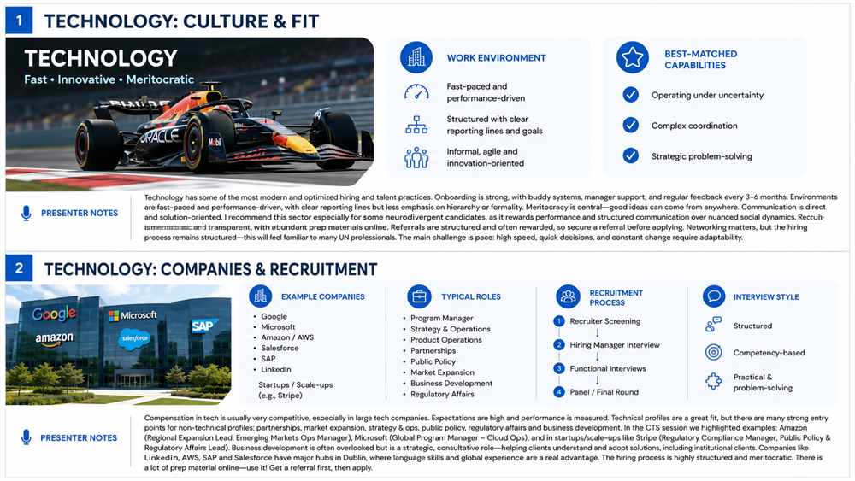
1. Tech
Notes:
Technology is one of the sectors that has modernized hiring and talent management the most. Compared to more traditional industries, technology companies have invested heavily in improving how they recruit, onboard, develop, and retain talent. In many of these organizations, the employee experience is carefully designed from day one, with structured onboarding, buddy systems, strong manager support, and regular feedback cycles every three to six months.
What makes technology particularly interesting is that it combines high structure with cultural informality. Reporting lines, Indicators (KPIs), and performance expectations are usually very clear. At the same time, the environment feels much less formal than traditional sectors. Dress code, hierarchy, and executive presence matter less. What matters much more is performance, execution, problem-solving, and the ability to create value quickly.
This is also a highly meritocratic environment. In many technology companies, good ideas can come from anywhere in the organization..
I would particularly recommend this sector for some neurodivergent candidates. Technology environments reward structured communication, logical thinking, and measurable performance, but and less so more nuanced social dynamics or informal relationship or status building. For neurodivergent candidates this is a highly enabling environment.

Slide 16
Tech_ Companies & Recruitment
Notes:
Compensation in technology is usually very competitive, especially in large tech companies. This is one of the reasons the sector is attractive for professionals transitioning from the UN. These companies pay well because performance is measured closely and in accordance to output.
Technical profiles are obviously a natural fit for this sector, but a common misconception is that technology only hires engineers or technical talent. There are many strong entry points for non-technical profiles, especially in partnerships, market expansion, strategy and operations, public policy, regulatory affairs, and business development.
A path that is often overlooked is business development. Many professionals hear “business development” and immediately think of aggressive sales. But in technology, business development is very strategic and consultative. It involves understanding client needs, identifying growth opportunities, building partnerships, and helping clients understand what technological solutions they need.
Companies like LinkedIn, AWS, SAP, and Salesforce have major hubs in Dublin where professionals support different international markets. For multilingual UN professionals, this can be particularly attractive.
And the recruitment process is relatively transparent, companies are very explicit about what they assess and how to prepare effectively. To apply you will need a combination of networking and formal applications, and this may feel somewhat familiar to UN professionals.

Slide 17
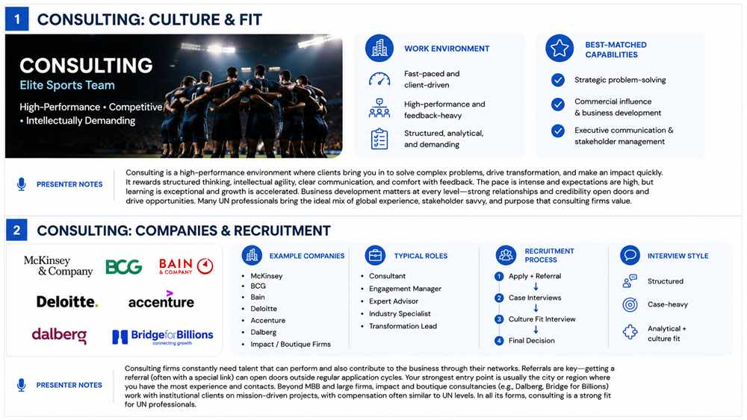
2. Consulting
Notes:
Consulting is one of the sectors I most strongly recommend you consider. Many professionals initially resist consulting because they associate it with aggressive cultures, but they might miss why consulting can actually be an exceptionally strong fit.
Consulting is fundamentally about solving complex problems for clients. Clients bring consultants in when they need expertise, strategic clarity, transformation, implementation support, or an external perspective. The work is intellectually demanding, fast-moving, and highly structured. Professionals coming from the UN can bring exactly the kind of capabilities consulting firms value: navigating complexity, managing difficult stakeholders, operating in ambiguity, and working in highly complex systems. Many also bring strong international exposure, different languages, and credibility in specialized environments.
The main challenge is intensity. This is a demanding environment but fantastic for professionals that are intellectually curious, resilient, comfortable with pressure, and motivated by challenge.

Slide 18
Consulting_ Companies & Recruitment
Notes:
Compensation in consulting is usually very strong, particularly in MBB, McKinsey, Bain and BCG, which are the top-tier strategy firms. Even outside top-tier, compensation is highly competitive and in many cases comparable and superior to UN salary levels.
A major advantage for UN professionals in Consulting is the experience in relationships with governments, and public institutions. Firms value professionals at any level, junior or senior, who can help generate business, build trust, and strengthen client relationships. These relationships you have built with these institutions are extremely valuable to them.
Another advantage is that UN professionals are unique positioned to work in impact consulting and specialized advisory firms that work with the public sector. ICF, Dalberg or Bridge for Billions work extensively with institutional clients and mission-driven projects.
Note that strong candidates apply with support from someone inside the firm or the local office. Candidates are referred directly and invited to apply through special internal links, or are invited to apply to their open positions.
Interviews are typically structured around case interviews followed by culture fit or behavioural interviews. Preparation matters a lot, and the good news is that there is a huge amount of preparation material available online for case interviews.

Slide 19
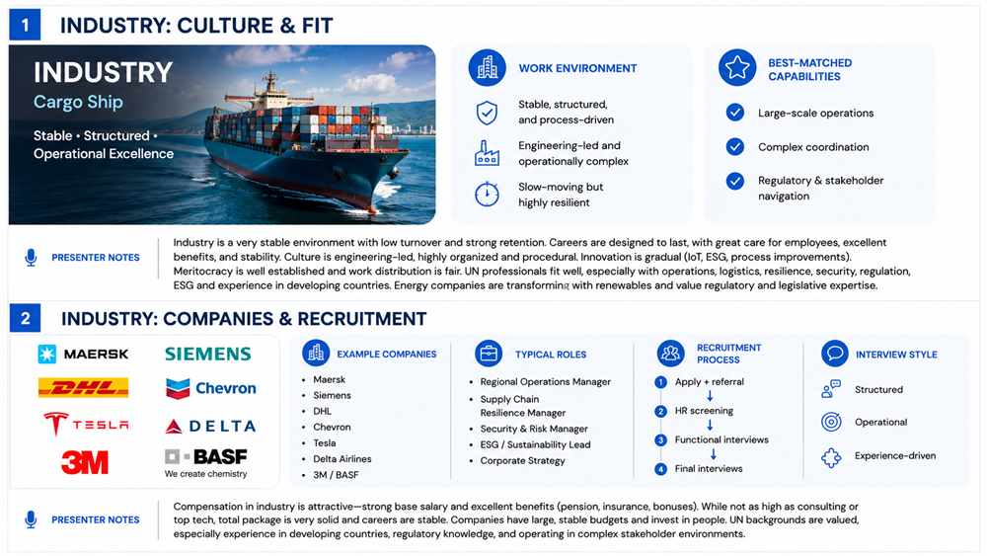
3. Industry
Notes:
Industry is a very stable environment with relatively low employee turnover. Many industrial companies design careers to last within the organization, so there is often a strong emphasis on retention, internal mobility, and long-term employee development. Promotions may not be as fast as in consulting but the trade-off is usually stability, and career progression.
This is an engineering-led culture but you do not need to be an engineer to work in the sector. These organizations are very structured, highly organized, and built around production sites, supply chains, and commercial offices. Roles and responsibilities tend to be clearly defined.
This is a sector where processes, compliance, and operational excellence, matter a lot. This is relevant sector for backgrounds from the UN in operations, logistics, resilience, security, infrastructure, regulation, ESG, or large-scale programme management. Experience in developing countries can be especially valuable because many industrial companies operate in global distribution networks and need professionals who understand local realities, regulatory environments, and operational complexity on the ground.

Slide 20
Industry_ Companies & Recruitment
Notes:
Compensation in industry is generally attractive. It may not reach the levels of consulting, finance, or top-tier technology, but it is usually strong and often comes with excellent benefits packages. These companies tend to have large, stable budgets and invest seriously in retaining talent.
A particularly interesting area is the ecosystem growting around industrial transformation. Alongside large industrial corporations, there are also smaller companies and scale-ups focused on ESG, logistics, and industrial technology, like Internet of Things solutions. These companies partner with larger industrial firms to solve operational and sustainability challenges.
Interviews are usually structured and practical. Hiring managers focus heavily on past experience, operational judgment, risk management, and problem-solving. Compared to consulting, there is less emphasis on abstract case interviews and more focus on real examples from prior work.

Slide 21
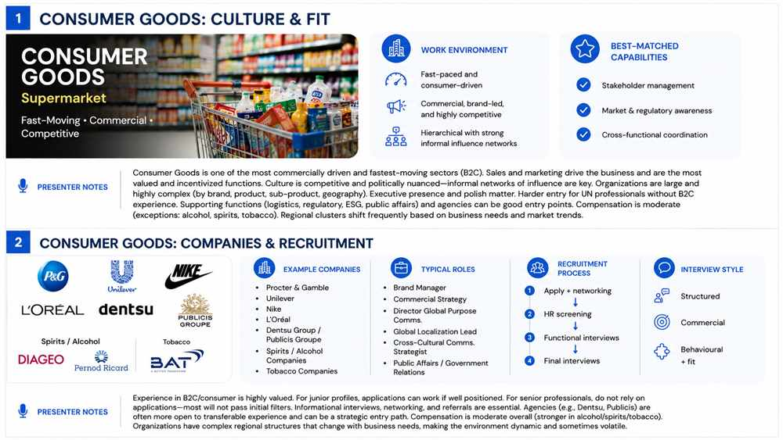
4. Consumer Goods
Notes:
Consumer Goods is one of the most commercially driven sectors and it moves fast because it is fundamentally Business2Consumer. Consumer demand drives the business, market trends shift quickly, and companies need to react to maintain growth, market share, and brand relevance.
The culture is strongly shaped by sales and marketing. These are usually the most valued and most incentivized functions because they drive revenue and market growth. Functions such as HR, finance, or support operations are generally less influential in decision-making than sales, and marketing.
Informal influence networks matter a great deal for career progression. Executive presence, polish, and people-savviness matter more here than in sectors like technology or industry.
An advantage for UN professionals would be to entry through supporting functions such as logistics, supply chain, regulatory affairs, ESG, and public affairs—because of experience navigating complex markets or working with regulators across multiple geographies.

Slide 22
Consumer_ Companies & Recruitment
Notes:
Compensation in Consumer Goods is less attractive than people assume. There is a common misconception that luxury or premium consumer brands pay exceptionally well, but this is often not the case. Compared to consulting, finance, or technology, compensation is usually more moderate. The exceptions tend to be companies with products that are generally held in less regard, like alcohol or spirits and tobacco, where compensation can be used as a talent attraction mechanism.
Recruitment tends to favour candidates with direct sector experience. Companies usually prefer hiring from within consumer goods or adjacent B2C sectors because they value commercial understanding and consumer mindset very highly. This makes entry more difficult for many UN professionals, especially at senior levels.
However agencies that serve large consumer companies, like Dentsu Group or Publicis Groupe, value transferable experience more and may not penalize lack of direct consumer sector experience. This can make them a more accessible bridge into the sector.
Entry into this sector is much more likely to happen through networking, referrals, internal sponsorship, and strategic conversations rather than through cold applications.
Interviews are usually structured but strongly focused on commercial mindset. Hiring managers want to assess whether the candidate understands consumer behavior, and wether they can operate in a competitive business setting.

Slide 23
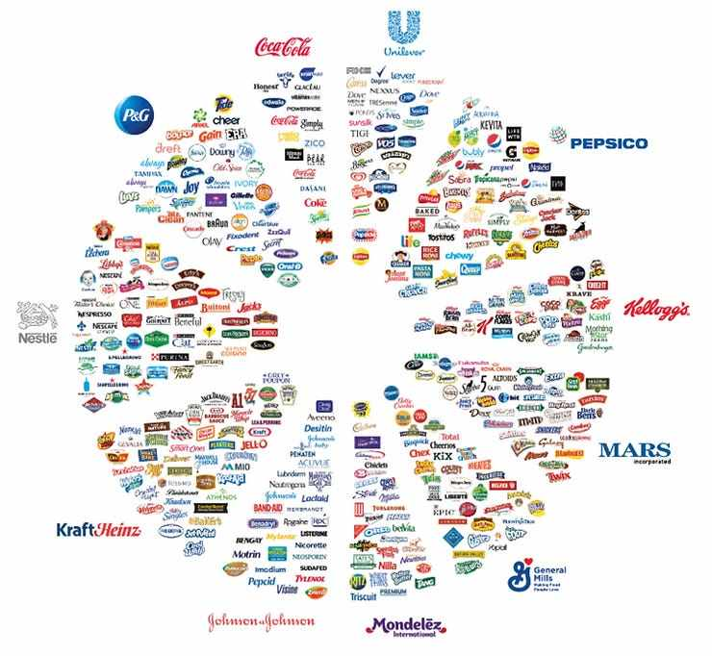
Consumer_ brands in companies
Notes:
Large consumer companies are by the way much more complex organizationally than they appear from the outside. As you can see in the picture, not every brand is a company on its own. I was very interested to learn that all the brands that we might now are owned by a handful of large corporations. A company like Procter & Gamble, P&G, has very many brands, and has intricate structures where teams are organized by product category, sub-category, brand, and market cluster. Understanding how the organization actually works is critical, so I might encourage to find out more about whichever company before you even consider it.

Slide 24
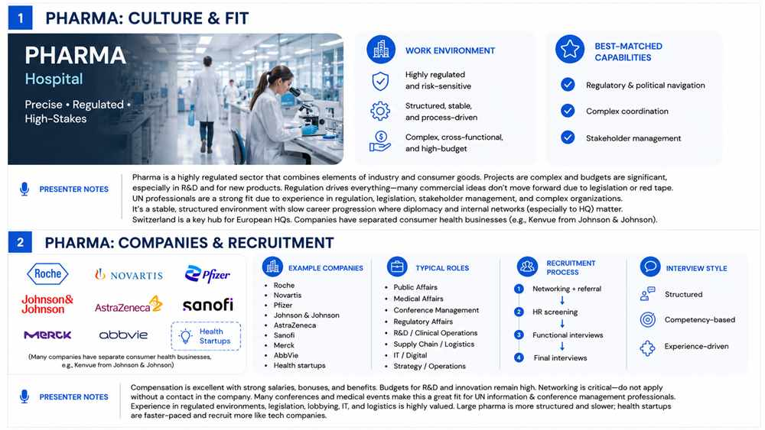
5. Pharma
Notes:
Pharma is a highly regulated environment with complex projects, and strong budgets. In many ways, pharma combines elements of industry and consumer goods. It has the operational complexity and process orientation of industry, but also the commercial and marketing focus of consumer businesses.
What makes this sector unique is the central role regulation plays in decision-making. Marketing and sales are important, but unlike consumer goods, execution cannot move fast. Regulation shapes almost everything. A large percentage of initiatives proposed by commercial teams may never move forward because of legislation, compliance requirements, or regulatory constraints. This means resilience is essential. Professionals need to be comfortable with delays, setbacks, and long decision cycles.
This is where UN professionals can be particularly strong. Experience working in highly regulated environments, navigating legislation, translates extremely well here. Profiles with experience in health, policy, operations, procurement, IT, logistics, or institutional relations can be especially competitive.
Pharma is also a highly structured and stable environment. Work is organized clearly, career progression tends to be relatively slow, and major organizational changes are less frequent than in sectors like technology. Informal influence still matters, particularly connections to HQ and visibility in strategic projects.
I would especially recommend looking at Switzerland if this is your current station for European large pharma headquarters, as it´s one of the most important hubs.

Slide 25
Pharma_ Companies & Recruitment
Notes:
Compensation in pharma is excellent. Pharma companies tend to have very strong budgets, particularly around R&D, product launches, and strategic initiatives.
Recruitment relies heavily on networking. As with consulting and consumer goods, I would strongly advise against applying without first building contacts inside the company. Having internal visibility or a referral can make a significant difference.
There is a particular advantage for professionals from UN information and conference management backgrounds. Because Pharma companies organize a large number of conferences, congresses, and medical events globally.
Pharma also offers strong opportunities in public affairs, regulatory affairs, operations, IT, supply chain, and institutional engagement. Because you might have worked with regulators, legislative bodies, healthcare systems, or close to lobbying environments.
It is also important to distinguish large pharma from health startups. Since COVID, the health startup ecosystem has grown significantly. These organizations can offer exciting opportunities, but culturally they recruit much more like technology companies than traditional pharma companies. The environment is usually faster, less structured, and more dynamic.

Slide 26
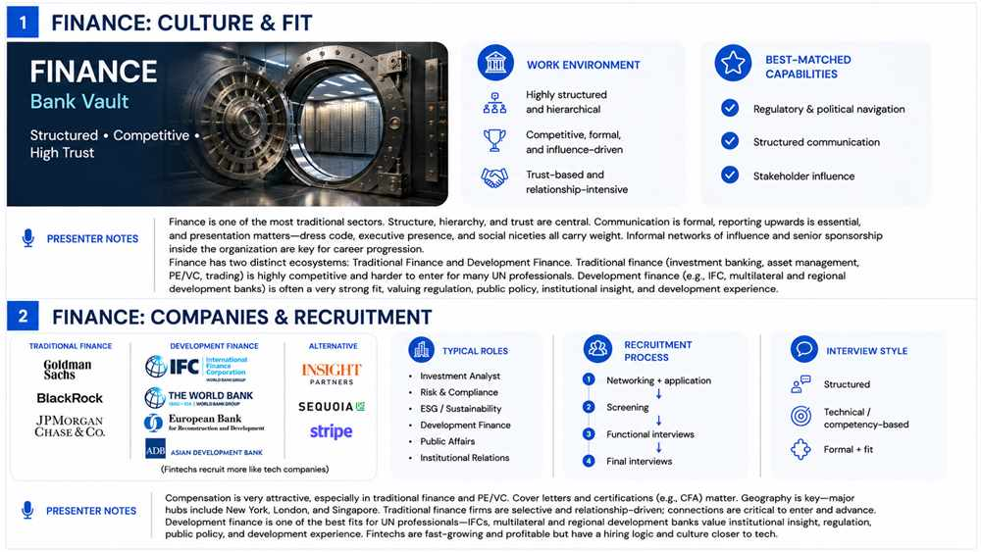
6. Finance
Notes:
Going into Finance there is one important nuance here which is that finance should really be understood as two distinct ecosystems: traditional finance and development finance. The culture in both is highly structured, formal, and performance-oriented, but the fit for UN professionals can be very different.
Traditional finance includes investment banking, asset management, private equity, venture capital, and trading. These environments are usually highly competitive, prestige-driven, and difficult to access without direct sector experience or very strong financial credentials.
Development finance, however, is a very strong fit for UN professionals. Institutions such as multilateral development banks, and regional development banks, they operate with strong finance logic, but they really value experience in regulation, institutional relations, public policy, and economic development. This makes finance a much more attractive sector for UN professionals than it may initially appear—provided we are clear about which part of finance we are discussing.

Slide 27
Finance_ Companies & Recruitment
Notes:
Compensation in finance is usually attractive. Recruitment is formal and highly competitive. Cover letters matter much more here than in many other sectors. Professional certifications such as CFA can add credibility, especially for candidates without traditional finance backgrounds.
UN professionals are very well positioned for development finance, because they already understand complex institutional environments, and regulation, and they have the advantage of having worked with with governments, central banks, and regulatory institutions.
I recommend looking closely at organizations like International Finance Corporation, World Bank, European Bank for Reconstruction and Development, and Asian Development Bank because they provide one of the clearest bridges between the UN ecosystem and the private sector. They retain the mission orientation many UN professionals value while operating with much stronger private sector logic, and performance expectations. Their recruitment logic and culture sit much closer to finance than to the broader UN system.
Fintech is another important category. These companies can be profitable and attractive, but culturally they recruit much more like technology start-ups companies than traditional finance institutions. The environment is usually faster, less formal, and more innovation-driven.

Slide 28
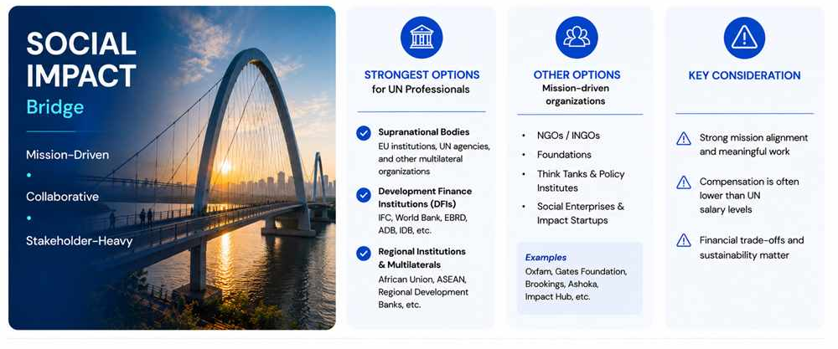
7. Social Impact
Notes:
I want to briefly mention social impact and mission-driven pathways, because for many UN professionals these are naturally attractive options.
The strongest opportunities in this space are usually supranational bodies, development finance institutions, and regional organizations. These environments often value UN experience very highly because the work is stakeholder-driven, international, and mission-oriented. The transition can therefore feel relatively natural.
Beyond this, there are also opportunities in NGOs, foundations, think tanks, and social enterprises. These can be very meaningful career paths, especially for professionals who want to remain close to mission-driven work, policy influence, or advocacy.
The main consideration here is compensation. This is often the biggest trade-off. While supranational bodies and development finance can offer compensation comparable to the UN, NGOs, foundations, and smaller social enterprises often cannot.

Slide 29
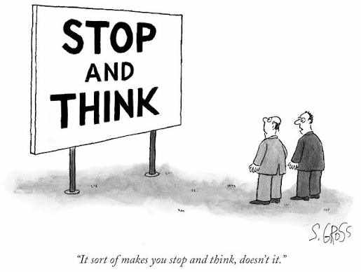
Sam Gross/The New Yorker Collection/The Cartoon Bank; © Condé Nast
Notes:
At this point, we have covered a lot of information. We’ve looked at 7 different sectors in the private market. I want to give you some time to breathe, think, and ask questions in the Q&A.
but we are not going into the Q&A just yet, first we have some work to do

Slide 30
WORKBOOK_ PAGE 6
REFLECTION_MODULE 1
Turn to page 6 of your Career Transition Workbook
Notes:
May I ask you now to join me in an exercise. Please open your workbooks and turn to page 6, look for the red pin, with the title REFLECTION next to it. I´ll give you a minute to do that.
Are you finding it alright?

Slide 31
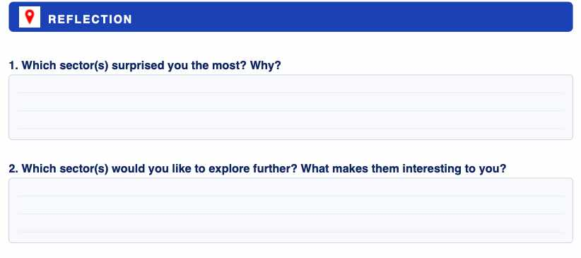
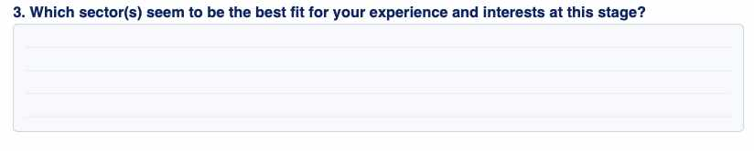
REFLECTION_MODULE 1
Turn to page 6 of your Career Transition Workbook
Notes:
Notice there are 4 questions that also spill onto page 7. These are what the questions look like for today: which sector or sectors surprised you the most and why, which sectors would you like to explore further and what makes them interesting to you, which sectors seem to be the best fit for your experience and interests at this stage.

Slide 32
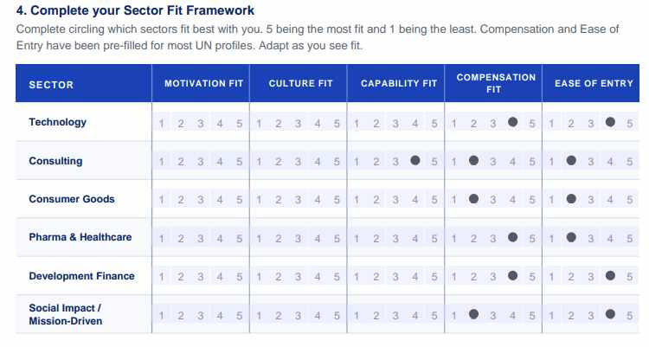
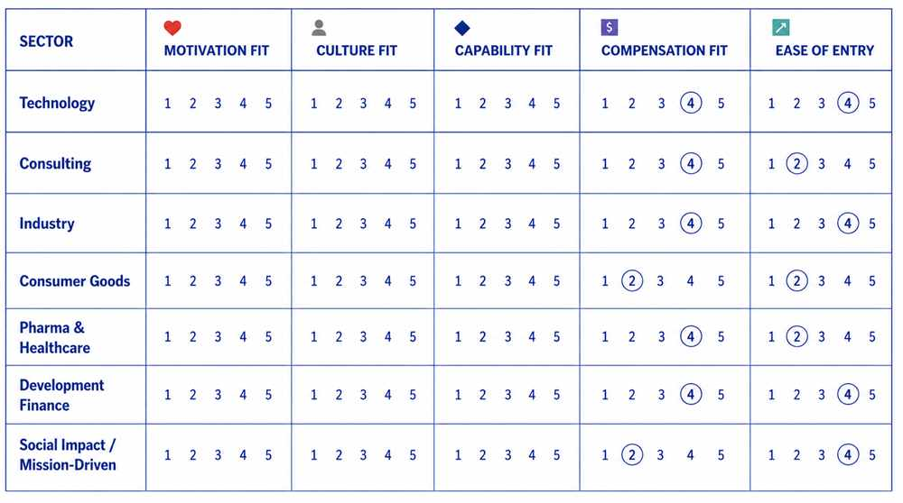
REFLECTION_MODULE 1
Turn to page 6 of your Career Transition Workbook
Notes:
The final question is a little chart that you need to fill in, so you might assess how each sector fits you. Please rank the sectors from 1 to 5. 1 being a very poor fit and 5 being the best fit.
I have pre-filled compensation and ease of entry for you, as they are relatively stable criteria from the UN professional standpoint.
Are you ready? You are going to have 10 minutes to answer the questions in the workbook.
TERESA, TO ACTIVATE TIMER GO TO SLIDE SHOW

Slide 33
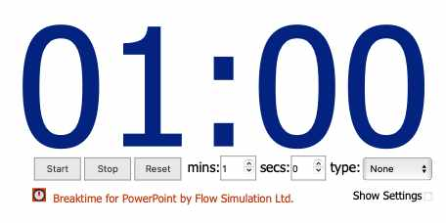
REFLECTION_MODULE 1_ PAGE 6
If you have time to spare you may start with Continue Your Journey questions directly below
Notes:
You have 10 minutes to answer the questions on the workbook. If you have time to spare you may get started with CONTINUE ON YOUR JOURNEY if not, this will be your homework.

Slide 34
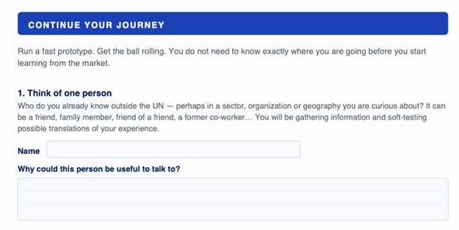
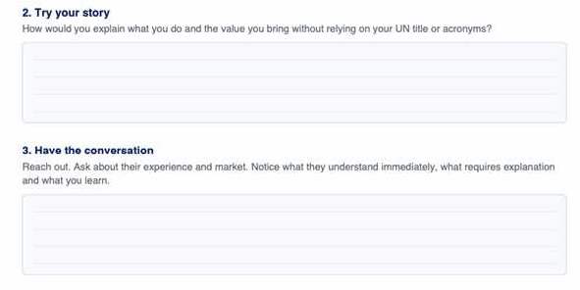
Post-work or homework
CONTINUE YOUR JOURNEY
Turn to page 7 of your Career Transition Workbook
Notes:
For next steps, I want to suggest you complete the exercise in CONTINUE YOUR JOURNEY on the following page.
And that was all for today, let´s go into the Q&A piece of the session.

Slide 35
Q&A_Mapping the Private Sector
TERESA CALLEJO
ROSA YLIMAULA
UNOG

Slide 36

Survey Form
Let us know your thoughts about the session!​
👉 Click here or scan the QR code.

Slide 37
Coming up tomorrow:
CAREER TRANSITION READINESS PROGRAMME
DAY 1. MAPPING THE PRIVATE SECTOR
DAY 2. DESIGN THINKING YOUR CAREER
DAY 3. JOB SEARCH STRATEGY
DAY 4. APPLICATION MATERIALS
DAY 5. COMPENSATION
HOMEWORK: Complete Continue Your Journey questions on Workbook page 7

Slide 38

Thanks for your participation!
Notes:
In light of the evolving organizational landscape across the UN system, building on the UN80 reform agenda’s emphasis on transformation and collaboration, UN Geneva, UNDP, UNHCR and IOM have launched the Career Transition Series: Pivoting Outside the UN System.
This inter-agency initiative responds to the growing need for practical career transition support, helping UN personnel navigate change and explore professional opportunities in the private and non-UN sectors.
Beyond the UN: Global Career Opportunities
Exploring Professional Pathways Beyond the UN System
An inter-agency career transition initiative
Jointly led by IOM, UNOG / UN Secretariat, UNDP, UNHCR and WHO
With technical and operational support from Global Careers
In light of the evolving organizational landscape across the UN system, building on the UN80 reform agenda’s emphasis on transformation and collaboration, IOM, UN Geneva, UN Secretariat in New York, UNDP and UNHCR are launching the Career Transition Series: Pivoting Outside the UN System. This inter-agency initiative responds to the growing need for practical career transition support, helping UN personnel navigate change and explore professional opportunities in the private and non-UN sectors.
Whether you are directly affected or proactively planning your next steps, this series will provide you with practical tools, expert insights, and the confidence to successfully pivot in today's evolving job market.

