Slide 1
UNFCU Advisors
Introducing
Blackden Financial
The UNOG Pre – Retirement Seminar 2020
Blackden Financial | International Partners with UNFCU.

Slide 2
Partnership
In 2015 UNFCU Advisors formed a Strategic Partnership with Blackden Financial, providing:
A dedicated financial advisor
Enhanced portfolio solutions
Local service, with global outreach
Tailored to your needs and risk tolerance
Ongoing monitoring and active management
Blackden Financial | International Partners with UNFCU.

Slide 4
On Retirement…
Blackden Financial | International Partners with UNFCU.

Slide 5
On Retirement…
Your financial life will change!
Preparing for retirement involves a certain amount of preparation for the unexpected such as:-
When you or your partner may die.
Your Health.
Inflation/The cost of living.
Reduction of your income
Management of the pension lump sum
More time to spend money
Taxes
We can help you better prepare for the future
Blackden Financial | International Partners with UNFCU.

Slide 6
As a Financial Planner, My Role is to Enable My Clients be Financially Stress Free Throughout Their Retirement
Have you a written plan?
At what age do you want to retire?
Do you know your pension entitlements?
Have you done a budget?
Where do you want to live?
What are your tax obligations?
Blackden Financial | International Partners with UNFCU.

Slide 7
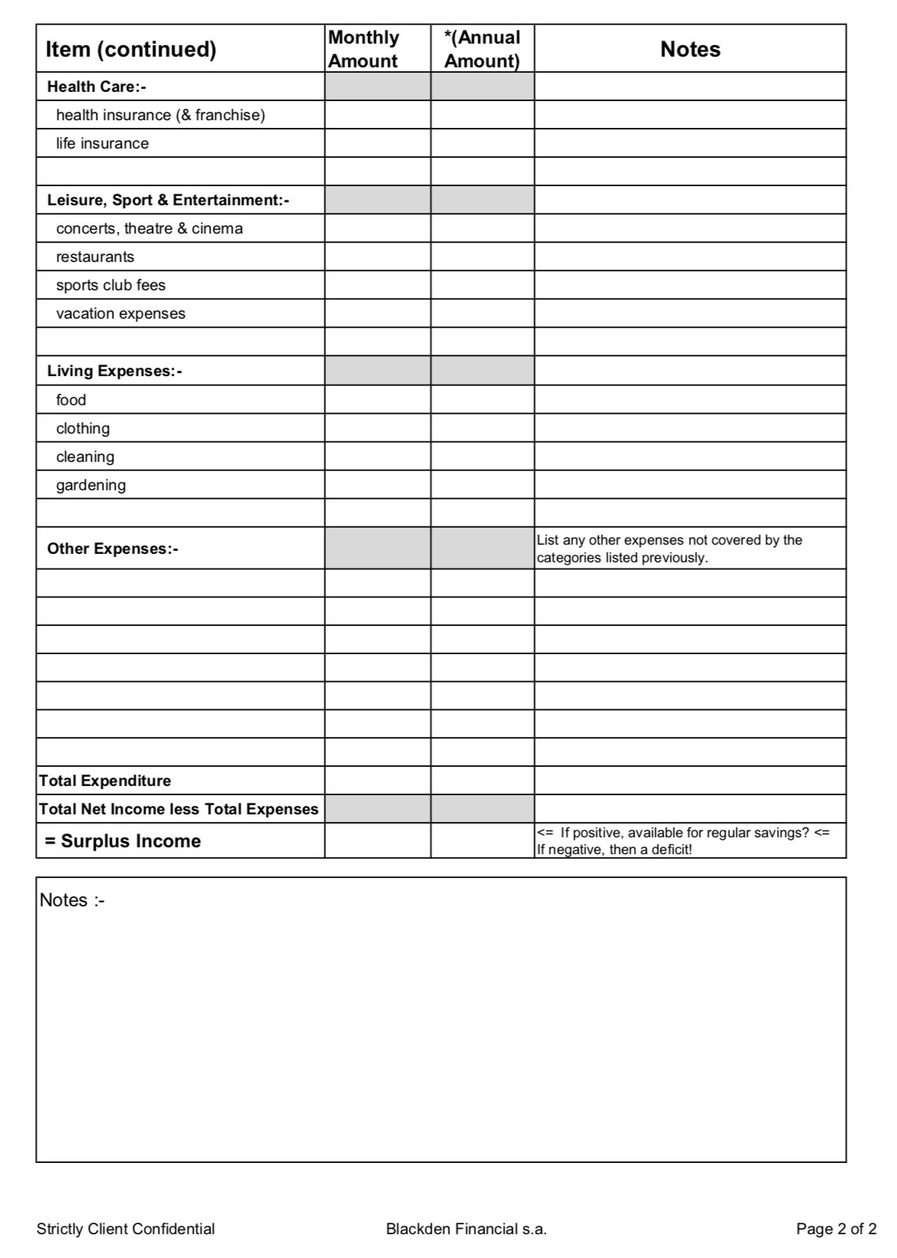

Slide 8
Saving
Be the best saver you can possibly be!
Aim to save at least 15% of your gross pay.
At aged 40 to save $1 million by 65 you need to save $750 a month with a growth rate 8%. This should give you an additional income of $50,000 on retirement.
Blackden Financial | International Partners with UNFCU.

Slide 9
Investment
Fixed interest with UNFCU
Managed Portfolios
ETF’s
Blackden Financial | International Partners with UNFCU.

Slide 11
Portfolio Management
Professionally managed, multicurrency investments available in CHF, EUR, USD & GBP
Wide diversification of asset class, markets and sectors
Investment strategy in line with your risk parameters
Blackden Financial | International Partners with UNFCU.

Slide 12
Investment Strategies
 |  |  | 6% | 7%
 |  | 5%
 | 4%
3%
Conservative | Defensive | Balanced | Dynamic | Growth
Expected growth
Volatility exposure
Blackden Financial | International Partners with UNFCU.

Slide 13
Tips to Enjoy Retirement.
Manage your Health.
Choose the best place to live. If moving Country rent before buying to try it out.
Pick the right Home.
Fill your time with Fun!
Blackden Financial | International Partners with UNFCU.

Slide 14
Summary
Think seriously about your aims and dreams.
Have a written plan and prepare a budget.
Use expert advise where required.
Take investment advise.
Feel free to book an appointment with me.
Blackden Financial | International Partners with UNFCU.

Slide 15
Questions

Slide 16
Questions to ask a Financial Advisor
How long have you been working as an advisor?
What professional qualifications do you have?
Do you focus on any particular areas?
Have you worked with other clients with similar situations?
Can you recommend other professionals such as an accountant or lawyer?
How often & by what means will you communicate with me?
How will I be able to monitor my plan & track investment performance?
How are you compensated for your services?
Blackden Financial | International Perspective, Independent Advice

Slide 17
Meet your financial advisor
Please contact Donald Noble to set a meeting at your convenience in his UNFCU office
Donald Noble
Financial Planner
dnoble@blackdenfinancial.com
+41 76 620 5546
Blackden Financial | International Partners with UNFCU.

Slide 18
Risk disclosure
This document was produced by and the opinions expressed are those of Blackden Financial SA, Geneva, Switzerland and as of the date of writing and are subject to change. The data contained within is provided for information purposes only and its accuracy is not guaranteed. It does not constitute an offer or an invitation by or on behalf of Blackden Financial SA to any person to buy or sell any security. Past performance is not an indication of future results.
Blackden Financial SA does not make any representation as to the accuracy or completeness of the information and analysis contained in this publication and does not accept liability for any loss arising from the use hereof.
Blackden Financial SA is a Swiss registered company, regulated in Switzerland by ARIF. ARIF is a self-regulating body approved by the Swiss Financial Market Supervisory Authority (FINMA) for the supervision of the financial intermediaries referred to in article 2 para. 3 of the Swiss Federal Law on combating money laundering and terrorism financing in the financial sector (AMLA). ARIF is also recognized by FINMA as a professional organization for laying down rules of conduct relating to the practice of the profession of independent asset manager within the meaning of the Swiss Federal Act on collective investment schemes
This document may not be reproduced either in whole, or in part, without the written permission of Blackden Financial SA
Blackden Financial | International Partners with UNFCU.

