Slide 1






WELCOME!
CAREER TRANSITION READINESS PROGRAMME
5 MODULES IN 5 DAYS

Slide 2



Zoom - Housekeeping rules
You are muted by default. The chat function is disabled.​
If you have any questions, please submit them through Zoom Q&A button.​
The session will be recorded. The recording and presentation will be available on: Career Transition Series webpage.

Slide 3

Teresa Callejo
Career Strategy & Development
10+ years helping global professionals gain clarity & confidence:
Navigating growth in transitions
Translating UN experience into market value
Notes:
Thank you for the kind introduction, and thank you for having me. For those of you joining today for the first time, my name is Teresa Callejo.
I'm an HR professional with a background in Talent Acquisition, Headhunting and Professional Development.
Over this series I am hoping to lend you my recruiter glasses to help you understand how the private sector thinks, where your experience might fit, and how you can start navigating that transition.

Slide 4
CAREER TRANSITION READINESS PROGRAMME
DAY 1. MAPPING THE PRIVATE SECTOR
DAY 2. DESIGN THINKING YOUR CAREER
DAY 3. JOB SEARCH STRATEGY
DAY 4. APPLICATION MATERIALS
DAY 5. COMPENSATION
5 DAYS INDEPENDENT CONTENT /1,5 HOURS PER DAY
7,5 HOURS YOU INVEST IN YOUR TRANSITION
1 TAKE AWAY WORKBOOK + RECORDINGS
Notes:
Today is Day 4 in the Career Transition Readiness program, we're going to cover your CV and LinkedIn as you would use them to position yourself in the private sector. And tomorrow Friday, Day 5, we'll look at compensation and salaries in the private sector.
There is a logic to the sequence, but don't worry if you have to miss a session. the sessions stand on their own. You are going to need your workbook which will be available in the chat.

Slide 5


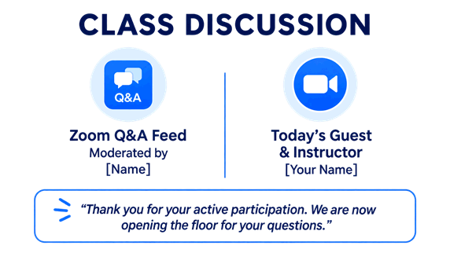
WORKBOOK_
1. Download and open the workbook
2. Find the practical exercises or REFLECTIONS in each Module
1. Page 6
2. Pages 9 & 13
3. Page 15
4. Page 16
5. Page 19
If you have to miss a session you can make it up with the Workbook
Notes:
May I remind you the workbook is a complement of the sessions and a practical takeaway of the whole journey. It has content, practical exercises, and post-work.
Please review it section by section on your own time because we already gave a little tour the first day, and now we want to go into the content.
Now, if you have not done so already please download the workbook and open it.
Now please find the practical exercises for each module, they are called REFLECTIONS. We will do this every day, find the reflection or exercise for the day in the workbook and give you time at the end of the session to do it. Today´s Reflection is on page 16.
I you miss a session you can make it up in the workbook and come the following day, no harm done.
Without further ado, let´s jump into today´s session

Slide 6
Agenda
1. CV for the private sector
2. LinkedIn for job search
3. Workbook REFLECTION _Module 4
Notes:
This is today´s agenda which is very simple, let´s try and reframe what a CV is and it was does. Go through the CV section by section and the LinkedIn section by section, and finally you will have time to test out your LinkedIn with an AI tool in the workbook.

Slide 7

A CV Follows Conversations
A CV will complement your job search strategy
Notes:
What is the actual purpose of a CV?
At its core, a CV is a calling card. Its job is to help someone quickly understand who you are, what you do, and where you create value. It is something you can use to apply to jobs, but also something you can share during a warm introduction, a referral, or when someone asks more about your background.
I want to be very clear here: in my experience, and in line with what many experts observe, applications alone are not the best way to find a new job—especially for experienced professionals. The hiring market has evolved dramatically. Globalization, ATS systems, remote hiring, and increased competition have changed the way recruitment works. So while your CV matters, we should place it in the right context.
A CV is best understood as a tool that supports your job search. It helps create credibility and clarity. But it is not the whole strategy.

Slide 8
When CV Works Most and Least
CVs tend to work best when:
✓ You are early-career
✓ You are applying for similar roles
✓ Same sector
✓ Same geography
CVs alone is less effective:
✓ Pivoting sectors
✓ Changing countries
✓ Making a career transition
✓ Targeting senior roles
Notes:
A CV tends to work best in situations where the hiring decision feels low-risk for the employer. For example, when you are early in your career, employers rely heavily on applications because junior hiring ismore structured and volume-driven.
CVs also work well when you are applying for roles that are very similar to what you have already done—in the same sector and often in the same country. That makes sense because hiring decisions are still heavily grounded in past experience. Employers will trust what feels familiar.
And this brings us to a very important concept: hiring is fundamentally risk-averse. Employers are constantly trying to reduce uncertainty. If your profile looks like someone who has already succeeded in the same environment, the CV works much better.
Some markets are more open to non-linear transitions—Canada is often a good example. Others like Europe are more traditional and conservative.
If you are deviating significantly from your previous path, the CV alone is much less effective, becuase your experience may be very valuable, but it is not immediately legible.
That is why I recommend having a strong CV that you can confidently share when asked, but to invest on a a structured job search strategy, just like we covered yesterday.

Slide 9
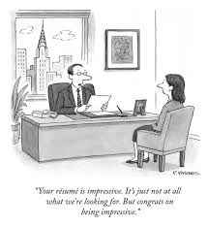
How I thought Recruitment Works
The New Yorker Collection/The Cartoon Bank; © Condé Nast
Notes:
To understand the real role of a CV, it helps to understand how recruitment processes actually work in practice.
This is the picture I had in mind when I first sent out my CV back in the day. I always imaged someone older and wiser, reading my CV attentively and figuring out how and where they would be using my impressive talents. In reality it´s more like this guy, you´re sending out resumes that are not what they´re looking for. At least in the cartoon the lady is getting an interview. Ok, jokes aside.

Slide 10
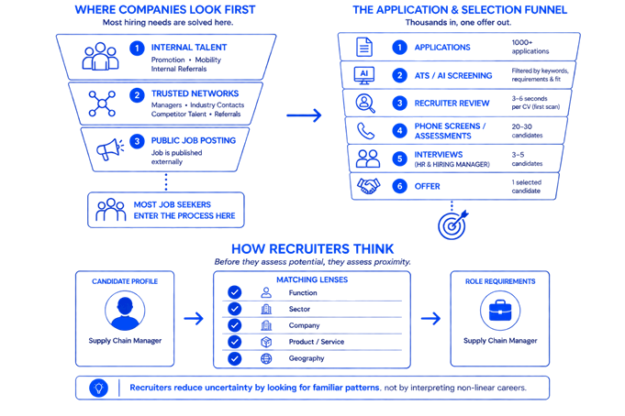
How Recruitment Really Works
Notes:
People like me thought the recruitment process began when the job was published. But publishing the vacancy is the last step, not the first!
Companies start by looking inward. They ask whether the role can be filled internally through promotion, mobility, or internal referrals. If that doesn’t solve the need, they move to trusted external networks—professional associations, sector contacts, competitor talent, or recommendations from managers. Only after these channels have been explored do companies formally publish a role externally on their website and or LinkedIn.
That means by the time a job appears online, the process may already be underway and possibly filled.
Then comes the application funnel: from thousands of applications, the ATS may reduce the pool to a few hundred. Then a recruiter or junior Talent Acquisition specialist reviews those CVs manually— using just 3 to 6 seconds per CV in the first screening. I know this because this was my first job in HR and executive search. At this stage, recruiters are not deeply analyzing profiles. They are scanning for fast signals of fit.
Typically, they look for things like work authorization, experience in geography, experience in the sector, company type, level of seniority, and sometimes language skills. Based on those signals, the shortlist narrows further to perhaps 20 to 30 phone screens or online assessments. And after this stage, you call 3 to 5 professionals for an interview.
In a standard recruitment process, your CV is being screened by technology, AI-enhanced systems, and recruiters whose main incentive is speed and efficient filtering—not creative interpretation. That’s why positioning matters so much. If your value is not immediately visible, the market won’t slow down to figure it out for you.

Slide 11
What Recruiters Look For
Notes:
At the first screening stage, recruiters are not asking, “Could this person eventually succeed here?” They are asking a much narrower question: “How close is this profile to what we need right now?”
Like we jus mentioned, recruiters screen first for a small number of dimensions that you cannot change: function, sector, company type, and geography. The closer your profile matches these variables, the safer the hire feels. Because this is what their job is, reducing applications to a manageable number to process, and doing it as fast as possible.
Let me give you a concrete example

Slide 12
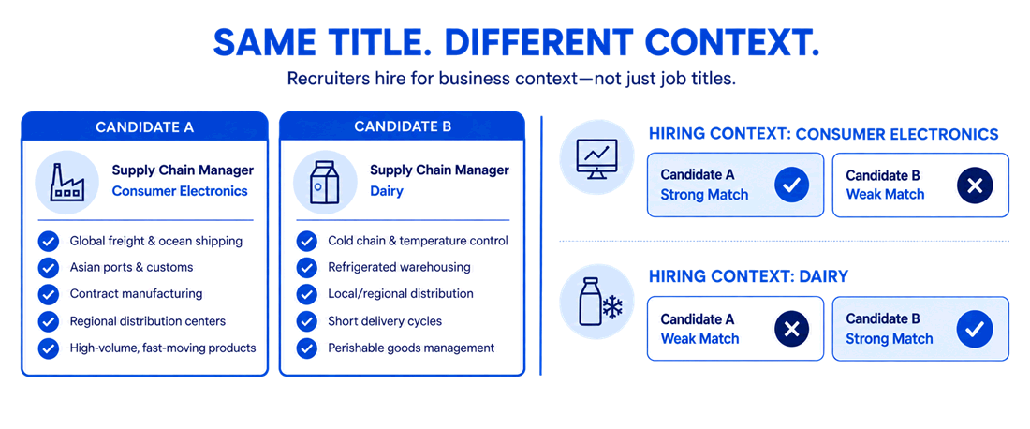
What Recruiters Look For
Notes:
Imagine I’m Talent Acquisition in a consumer electronics company. I am hiring for a Supply Chain Manager. The first thing I’ll look for is: does this CV show supply chain experience? Does it show experience in consumer goods? Better yet, experience in electronics manufacturing or distribution?
I’ll want to see experience with transportation methods we use in my company—freight, warehousing, global logistics, distribution networks, maybe Asian port infrastructure if we’re sourcing heavily from that region.
Now imagine instead I am a consumer company in Dairy, milk, yogurt, etc. I am am also hiring for supply chain, but the business context is entirely different. Dairy is highly perishable. Freight and global shipping experience are not relevant any more. Now I want to see in the CVs things like: cold-chain logistics, refrigeration systems, short delivery windows, and dense regional distribution networks.
Ideally I want someone that comes from logistics in Dairy, but I already made a list of possible companies that have cold-chain logistics, like healthcare or vaccine distribution companies. Or even fresh grocery delivery companies like Glovo or the Turkish Getir.
So even when two candidates share the same functional title, like Supply Chain, their relevance is completely different depending on the context.

Slide 13
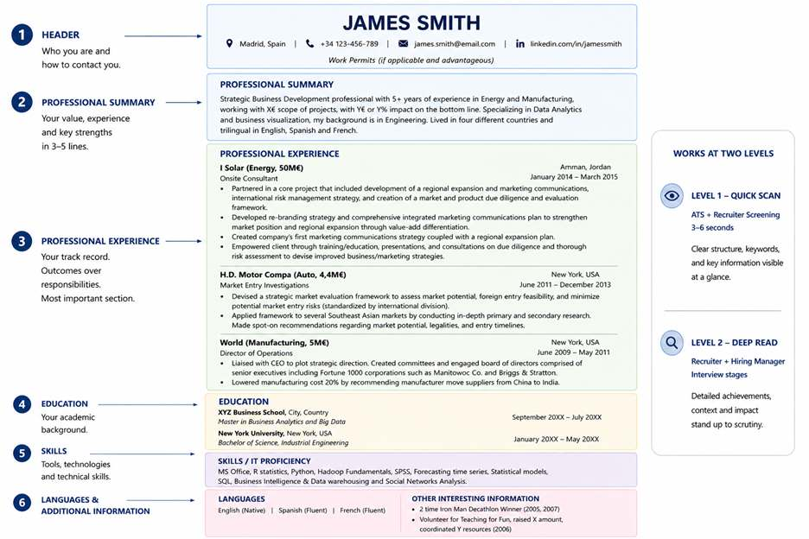
Your CV Must Work at Two Levels
Notes:
So at this point, you already figured out that your CV needs to work at two different levels. The first is the quick scan. This is the ATS stage and the initial recruiter screening, where your CV may get just 3 to 6 seconds of attention. At this stage, the goal is very simple: signal relevance fast. Can the recruiter quickly understand who you are, what you do, and whether your experience is relevant?
The second level is the deep read. This happens later in the process—during interviews, where recruiters and hiring managers will look closely at your career trajectory, your achievements, and whether your story makes sense.
For a professional in transition, CV screening is not your friend. The quick scan will very likely rule you out, that´s why you need to build your network, to meet the hiring managers that will understand and support your value.
Now let’s go section by section and look at what each part is meant to achieve, and how to adapt UN experience to fit private-sector expectations

Slide 14
1. Header
Contact information
Pictures are not recommended unless customary in local market
Notes:
Let’s start with the header. The purpose of the header is very simple: it provides basic contact and work information. In most cases, all you need is your name, location, phone number, email, LinkedIn, and—when relevant—work authorization.
If you already have the legal right to work in a target geography include it clearly like "Authorized to work in Switzerland". Most private sector employers do not sponsor frequently.
I would not recommend a picture generally speaking, but there are, of course, market-specific exceptions. CV norms vary by geography. For example, Germany still tends to favor CVs with a professional photo, whereas in many Anglo-Saxon markets that would be unusual or even discouraged. So while there are general best practices, always keep the local market in mind.

Slide 15
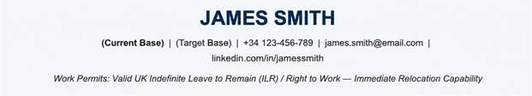
1. Header_ LOCATION
Applying to other countries?
List current + target location: recruiters looking will see your CV as a local match.
Use this approach ONLY if legally authorized to work in target location and willing to fund your own travel for interviews.
Notes:
Location matters more than many professionals realize. Recruiters use location to figure out if it would be easy to get you through the door, for an interview of for a job. Even if you are fully willing to travel for interviews or relocate quickly, recruiters cannot assume that. Remember they are on a clock and there are thousands more CVs to screen.
So make sure you include your target location, being explicit that you consider it a base, that you have a legal right to work there and that you are able to quickly travel for interviews and relocate there.

Slide 16
2. Professional Summary
Communicate your value proposition quickly
Align with your target location if different from current
Notes:
The professional summary is where you write an executive summary of your profile that almost anyone can understand quickly.
This is also one of the best places in the CV to include the most important keywords, metrics, and positioning signals that you want the market to see early. Think of it as the headline version of your professional story.
This is also a great place to demonstrate

Slide 17
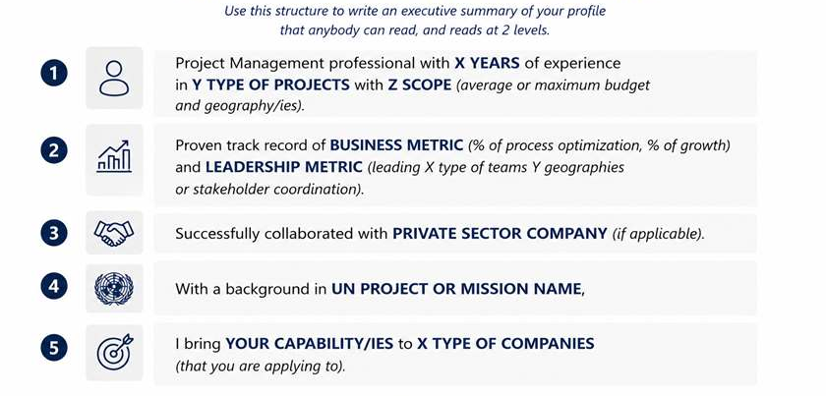
Professional Summary_template
Notes:
Please look at this template for a minute and I will read out loud a real example.
“Project Management professional with 12 years of experience leading 50M€ humanitarian and development programmes in Africa and Latin America. Proven track record of improving operational efficiency by x% and coordinating multi-stakeholder delivery in complex environments. Successfully collaborated with government institutions, NGOs, and private-sector partners. With a background in emergency response and programme delivery, I bring strong capabilities in strategic execution, stakeholder management, and operating under uncertainty.”
Notice what this does. It immediately translates the profile into market language. The recruiter does not need to interpret what a UN title means or what a specific programme involved. They can quickly understand the level, scope, and value of the experience.
However, this is the hardest section to do, it tends to be easier once the other sections are done. If you get stuck here, don’t force it. Leave it for later.

Slide 18
3. Professional Experience
Relevant experience, scale and impact.
Notes:
The Experience section is the core of the CV. This is where recruiters spend most time and where your relevance is really assessed. The goal is to highlight the experience that is most relevant to the market or role you are targeting.
I want to say this again: list experience that is relevant to the market or role you are targeting. So NOT like a PHP
For long careers or complex UN profiles, you´ll want to summarize. If you held multiple roles in one organization, lead with the most senior or most relevant one and summarize the rest. Try avoiding internal grades like P3, P4, or NO-C. They mean very little outside the UN.
I want to give you a couple tips on professional experience, so first notice how the company names in the example have a parenthesis next to them. Like “I Solar (Energy, 50M€)” at the top of the document, the most recent experience in this CV. Notice how next to the company there is a parenthesis with the sector and the revenue of the company.
This is so that in the quick read, the recruiter can place the company immediately in the market. Unless it´s coca-cola, it´s hard to know what each company does. And the measure of the scope will be revenue. This is immediately telling of the candidates experience. Are they used to large multinational environments? Have they ever worked for a smaller company? If I am coca-cola, I want the candidate to have worked in large multinational environments. If I am hiring for a start-up I ideally want to see that this person has experience in smaller environments where you do your own copies and get your own coffee so-to-speak.

Slide 19
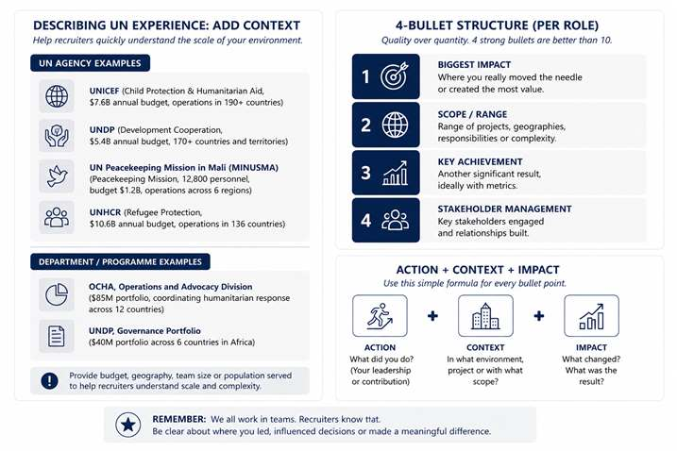
Professional Experience_template
Notes:
For UN professionals it´s better not to say label UN as just PUBLIC SECTOR. It´s true but it´s a very simplistic description and falls short to really convey the incredible scope of UN.
I drew up some ideas to describe UN experience adding a bit of context: UN Agency Name (Humanitarian Response, $4.2B annual budget), UN Mission Name (Peacekeeping Mission, 12,000 personnel in 5 regions), or Department Name ($40M portfolio across 6 countries). This helps recruiters understand scale fast.

Slide 20
Professional Experience_template
Notes:
And I know you know about bullet points, but since a private sector CV should be short, it´s better to have four strong bullets than ten descriptive ones.
Use a simple structure, SOAR or whatever other structure. I use Action + Context + Impact and a use 4 standard bullet points.
Bullet number 1 to show your biggest impact, where you really moved the needle. Bullet 2 can show scope: range of projects, geographies, or complexity. Bullet 3 can show another strong achievement. Bullet 4 can highlight stakeholder management, which is often a major transferable strength for UN professionals.

Slide 21
4. Education
Provide higher Ed. background and relevant credentials
Notes:
There’s usually not much to Education. Keep it simple and easy to scan.
Include:
Degree
Institution
Graduation year (optional for senior profiles)
Other certifications and credentials can be placed in a separate section such as Skills or Additional Information.
.

Slide 22
5. Skills / IT
Most relevant IT Skills for target company/sector
PMP – Industry / SQL – Technology / Excel Advanced or CFA – Finance / Power BI or Tableau – Consulting
Notes:
This section is relevant to capture the most relevant skills that are usually hard requirements. Here are some recommendations per sector based on hiring trends in my experience, but obviously this will be in the job descriptions and will come up in informational interviews.
PMP for an industrial environment, SQL for Technology, Advanced Excel for Finance, Power BI or Tableau or other data visualization tools for Consulting.
Since space is limited, you don’t have to write out the certification that proves it.
A little hack: if you identify a hard skill that you do not have, do not wait to have a certification, write it down in the CV and take a tutorial, a coursera, whatever it is. In most cases, you are not applying to be a technical expert in the skill, what the recruiter and the company is looking for is that you can use it in a business context, with other people that are proficient in it, or use it for reporting.

Slide 23
6. Languages
Show working profficency, not certifications
Repeat at the top, next to your name if not evident
Notes:
Languages can be a very important differentiator for you.
There is usually no need to include certificates. But if a language is especially relevant for the role, don’t wait until this section to mention it. Bring it up earlier in the Header or Professional Summary.
This matters a lot in markets where language is a major hiring filter, such as Japan or France. If you are fluent in the local language, but perhaps your name is not typical in that market, make the language visible immediately at the top of your CV. For example, my name is Teresa Callejo Pajares, with all it´s Js I am not expecting anyone to assume I speak English so I mention it at the top.
Don’t assume recruiters will infer language ability. I’ve seen bilingual candidates miss initial calls simply because it wasn’t obvious from the CV. If language is a strong asset, surface it early.

Slide 24
Other Interesting Information
Show personal interests and impact
Notes:
This section is optional, but it can be very useful when used strategically.
It’s a good place to include information that helps humanize your profile and show a bit more of who you are beyond your professional experience.
This can include hobbies, sports, travel, volunteering, additional recognitions, or other personal interests.
The important question is: why are you including this? What signal are you trying to send?
For example, sports usually signal discipline, resilience, or teamwork. Travel may reinforce curiosity, adaptability, and international exposure. Volunteering can highlight values, leadership, or community engagement. I want to make clear that this is all very business and western and may not apply to all geographies, make sure to adapt to the local reality.

Slide 25


CV vs LinkedIn
CVs
Targeted
Private
Tailored
Static
Role-specific
LinkedIn
Dynamic
Public
Broadly visible
Searchable
Network-driven
Notes:
Now that we’ve covered the CV, let’s move into LinkedIn.
The CV and LinkedIn serve different purposes, even though they similar information on them.
Your CV is a targeted document and LinkedIn is one public professional profile. LinkedIn helps you build visibility, credibility, and access before the process even begins.
This is especially important in the private sector, where opportunities are mostly relationship driven, not application driven.

Slide 26
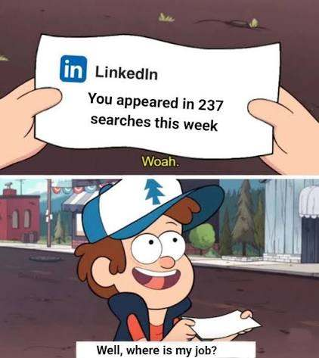
How Recruiters Use LinkedIn
Search
Validate
Assess
Connect
Internet meme, I couldn´t resist
Notes:
You want your LinkedIn to complement your efforts of relationship building. For reaching out to professionals and speaking to them.
Is is true that sometimes recruiters may contact you, but only for your past experience, not for a career switch that you are working on.
Recruiters mainly use LinkedIn in four ways.
First, to search for candidates using keywords such as job title, sector, and location. It´s the worlds largest database.
Second, to validate profiles. If someone receives your CV, they usually look you up on LinkedIn to confirm experience, credibility, and positioning.
Third, to assess relevance quickly. They want to understand whether your experience aligns with the role they are hiring for.
And fourth, to look at network proximity. Mutual connections, shared organizations, or shared professional circles matter.
This is very similar to the UN ecosystem. Being connected to the right people matters. It matters if you are connected to hiring managers, recruiters, professionals in target organizations, or former colleagues who have already moved into the private sector.

Slide 27
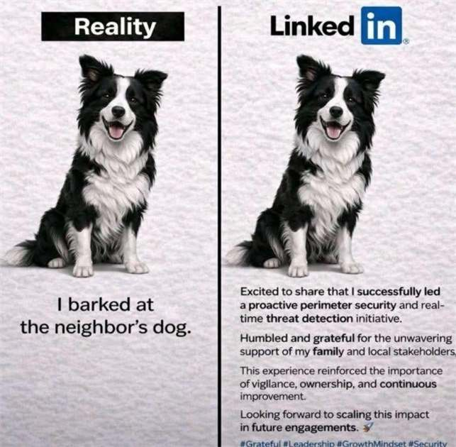
First Approach to LinkedIn
Start with:
1 Headline
2 About
3 Banner and Picture
4 Body of profile
Internet meme, I couldn´t resist
Promise it´s the last one
Notes:
Before you ask me: no, you do not need to be self-aggrandizing. You just need to have a working profile and interact a bit every once in a while. Like in the meme I´m showing you here, sometimes people go overboard with their accomplishments.
So in order to simply things and avoid overwhelm let´s focus on the sections people see first and the ones that shape immediate perception: your profile picture, your banner, your headline, and your about section.
This is where most of your effort should go.
Why? Because these sections do most of the work in the earliest moments of interaction and rank the highest in the algorithm search.
Everything else—experience, certifications, media, recommendations—still matters, but much of that can largely mirror your CV.

Slide 28
1. Headline
FORMULA:
“JOB TITLE | KEY WORD | KEY WORD | KEY WORD | TAGLINE”
Programme Manager | Operations | Strategy | Stakeholder Management | Helping organizations deliver complex projects across global environments
Position your profile for visibility and searchability (key words)
Notes:
The headline is one of the most important parts of your LinkedIn profile.
In many ways, it is the LinkedIn equivalent of your professional summary or positioning statement.
It is one of the first things recruiters see, and one of the fields LinkedIn weighs most heavily in algorithm search.
Your headline should be written strategically for your target audience, which usually means people in your target sector.
Recruiters typically search using combinations of job title, location, sector etc. Your headline is one of the best places to make these signals visible.
When someone sees your profile, they should quickly understand what you do, what you are good at, and where you fit.
A simple formula I like is:
Job Title | Keyword | Keyword | Keyword | Tagline
The job title should be the most market-readable version of the role you want, not necessarily your current internal title.
The keywords should reflect the skills, tools, and sector terms that appear in the roles you are targeting.
The tagline is optional, but it can be powerful. It helps explain who you help and how you create value.
For example:
Programme Manager | Operations | Strategy | Stakeholder Management | Helping organizations deliver complex projects across global environments
The easiest way to build a strong headline is to study job descriptions. Look at 5 to 10 roles you are genuinely targeting and identify the keywords that appear repeatedly.

Slide 29
2. About
FORMULA:
“JOB TITLE | EXPERIENCE | SKILLS | INDUSTRY | TARGET ROLE”
+
Expertise: bullet, bullet, bullet
+
About me: emoji + words, emoji + words
Position your profile for networking and opportunities
Notes:
The About section is where you bring everything together.
This is your professional narrative. It should help someone quickly understand what you do, what you are good at, and what opportunities you are targeting.
Unlike the headline, this section gives you a bit more space to explain your story.
A simple structure I recommend is:
Job Title + Experience + Core Skills + Sector + Target Role
Start with the most market-readable version of who you are professionally.
Then explain your years of experience, core strengths, and the environments where you have worked.
Finally, if relevant, mention the type of opportunities you are targeting to include them as key words! So super useful. And as always, use market language rather than internal terminology whenever possible.
YOU CAN USE BULLET POINTS, ICONS, LISTS of tools, lists of things you do well... anything, and maybe include a section about yourself, to talk about the kind of person you are and what you believe in.

Slide 30


3. Banner & Picture
Notes:
What do you think of these profiles? Just based on their picture and their background. Do you know what they do?

Slide 31
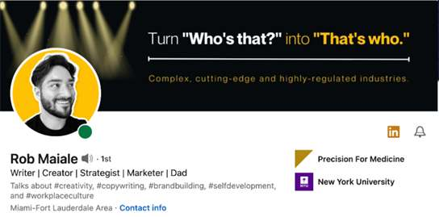
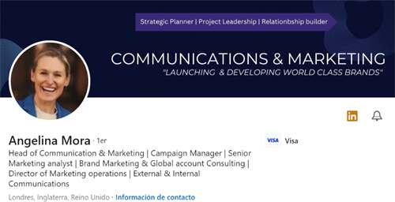
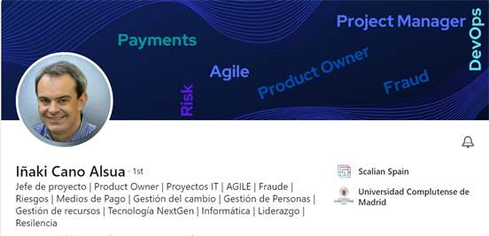
First Impressions_strong examples
Notes:
What do you think about these profiles? Do you know what they do?
Which profile would you like for yourself? the ones from the prior slide or this ones.
Your profile picture and banner are prime visual real estate on LinkedIn. Together, they shape first impressions before anyone reads your headline or About section.
The banner is not optional. The words there will not be picked up by the algorithm, because they are in a picture, but they will signal early and strong to a person looking at your profile.
Tools like Canva or Cultivated Culture can help you build something quickly and professionally.
Think of your banner as supporting your headline. Together, they should reinforce what you do and where you create value.

Slide 32






First Impressions
The my best photo on my phone
The planet head
The AA (Adrenaline Accountant)
The wedding crasher
The Dr Dolittle
The Globe Trotter
Notes:
These are some funny styles to avoid. Please make a good foto just for LinkedIn with a neutral background and a shirt.

Slide 33
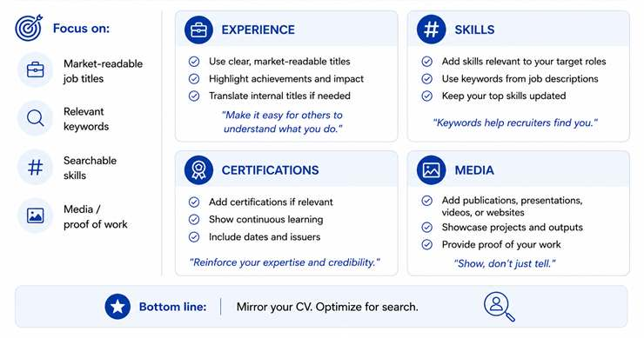
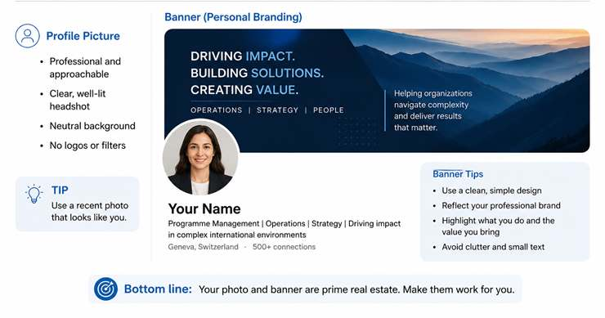
4. Body of LinkedIn (experience, etc)
Reinforce credibility and improve searchability
Every key word should be present x13
When in doubt, use your actual title and your “translation”
Notes:
I would recommend the Experience section of LinkedIn be mostly like the CV.
Except the job titles. If your present or past title is very internal, niche, or difficult to understand outside the UN, consider translating them into more market-readable language. If you are more comfortable use a translation of your title AND THEN your official title.
And to help the algorithm as much as possible, the most important key words and skills should appear at least 13 times. It also helps real people looking at your profile, to understand what you do.

Slide 34
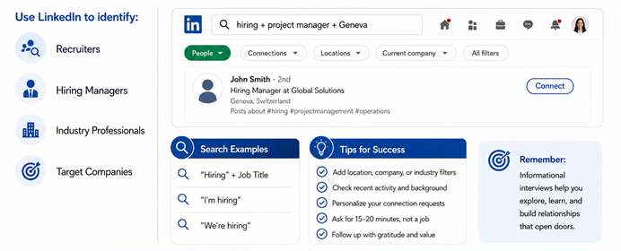
Extra Push For Informational Interviews
Purpose:
More targeted informational interviews
Notes:
One of the most powerful uses of LinkedIn is identifying the right people for informational interviews.
This includes recruiters, hiring managers, professionals in your target sector, or people working in organizations you are interested in.
A simple and effective method is searching LinkedIn using hiring-related keywords.
For example:
“Hiring” plus job title.
“I’m hiring.”
“We’re hiring.”
You can also add filters such as location, company, industry, or remote.
This helps you identify people who are actively hiring or closely connected to hiring decisions.
This is extremely useful because it helps you move closer to decision-makers and the organizations you care about.
And remember, the goal is not necessarily to ask for a job.
The goal is to identify relevant people, understand market demand, gather insights, and build strategic relationships.
This approach complements your informational interview strategy very well.

Slide 35
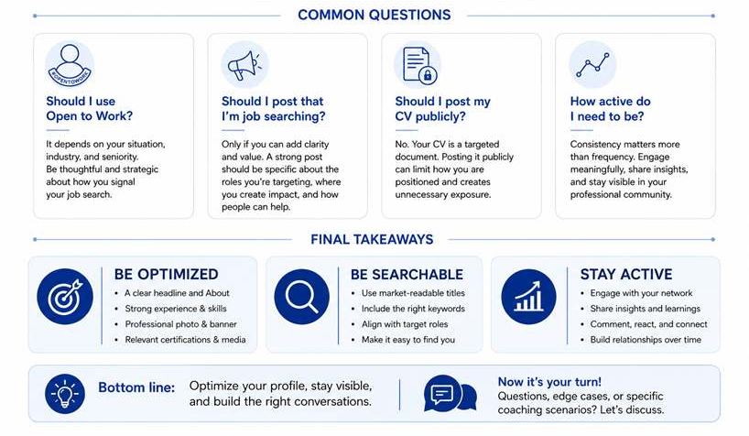
LinkedIn FAQs / Final Call To Action
Notes:
Before we close, I want to address a few common LinkedIn questions.
One of the most common is whether to use Open to Work or publish a post announcing that you are job searching. My general recommendation is to be thoughtful and strategic.
I do not recommend posting your CV publicly on LinkedIn. Your CV is a private and targeted document and for different roles. Posting one version publicly can limit your positioning and creates unnecessary exposure.
I’m also cautious with highly visible Open to Work signaling, especially for senior professionals. Positioning matters, and I generally prefer signalling through networking, outreach, profile optimization, and direct conversations. That said, every situation is different.
If someone absolutely needs to make an Open to Work post be specific about the roles you are targeting, locations, value proposition, and how people can help. Perhaps in a in post about it, not just the green open to work banner please, because if you are still active, I don´t understand why it´s there, and if you are actively looking, what are you looking for?
At the end of the day, everything waht we covered comes down to three principles. Have your profile be optimized, be searchable and stay active.
If you do those three things consistently, LinkedIn is a good complement to your job search strategy.

Slide 36
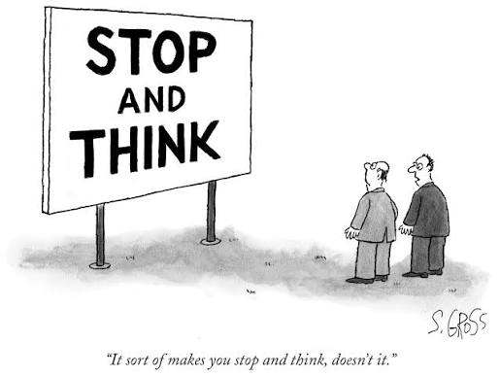
The session will be recorded. The recording and presentation will be available on: Career Transition Series webpage.
Sam Gross/The New Yorker Collection/The Cartoon Bank; © Condé Nast
Notes:
At this point, we have covered a lot of information. Please know the session will be recorded and shared. Slides will be ready by tomorrow and the recordings by next week. We need time to work our magic!
With this in mind I want to give you some time to breathe, think, and ask questions in the Q&A.
but we are not going into the Q&A just yet, first we have some work to do

Slide 37
WORKBOOK_ PAGE 16
REFLECTION_MODULE 4
Turn to page 16 of your Career Transition Workbook
Notes:
May I ask you now to join me in an exercise. Please open your workbooks and turn to page 16, look for the red pin, with the title REFLECTION next to it. I´ll give you a minute to do that.

Slide 38
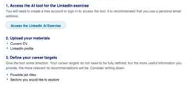
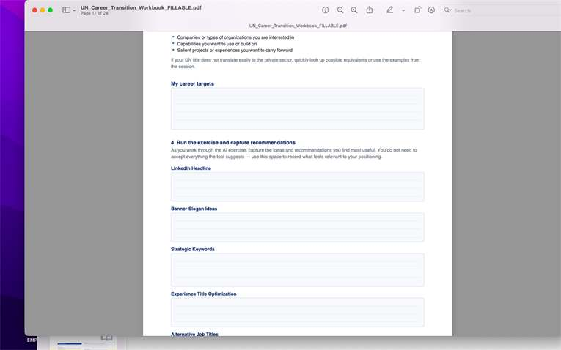
REFLECTION_MODULE 4
Turn to page 16 of your Career Transition Workbook
Notes:
Notice there are 4 questions that also spill onto page 17. These are the instructions for today: 1 Access the AI tool for the LinkedIn exercise. Note that it will ask you to create an account. 2 upload your materials, your current CV and your LInkedIn profile. 3 Write down on the workbook and the tool your Career Targets, you have some clues on the workbook, if you want some help.

Slide 39
REFLECTION_MODULE 4
Turn to page 16 of your Career Transition Workbook
Notes:
The final instruction is for you to run the tool. And in the workbook, copy and paste the most interesting content the tool gives you.
Notice where the tool works best, possibly for key words, and where you might need to edit as the phrasing is perhaps not exactly what you would say. At any rate it will be helpful.

Slide 40
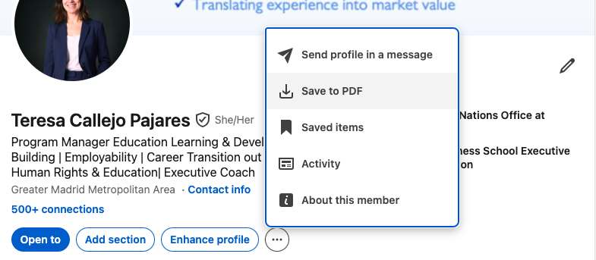
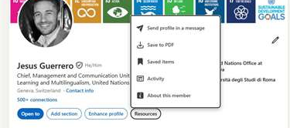


LinkedIn AI_ download your LinkedIn pdf
Notes:
By the way, let me show you where you can download your Linkedin profile. Please look at the screenshots before you. Go to your linkedin profile online.
Notice below your name and headline there are some buttons: there is a 3 DOTS BUTTON or a RESOURCES BUTTON. And the option to save to pdf will appear as you see on screen.
Are you ready? You are going to have 10 minutes to answer the questions in the workbook.
TERESA, TO ACTIVATE TIMER GO TO SLIDE SHOW

Slide 41

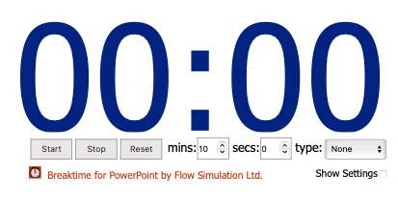
REFLECTION_MODULE 4_ PAGE 16
“Little Lights” Beauvois
If you have time to spare you may start with Continue Your Journey questions directly below
Notes:
You have 10 minutes to run the tool and answer the questions on the workbook. If you have time to spare you may get started with CONTINUE ON YOUR JOURNEY if not, this will be your homework.

Slide 42
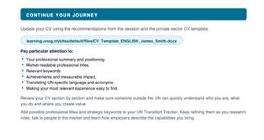
Post-work or homework
CONTINUE YOUR JOURNEY
Turn to page 18 of your Career Transition Workbook
Notes:
For next steps, I want to suggest you complete the exercise in CONTINUE YOUR JOURNEY on the following page. You will see it is updating your CV, we´ve provided a template for you to use if that is convenient.

Slide 43
Q&A_Mapping the Private Sector
TERESA CALLEJO
ROSA YLIMAULA
UNOG

Slide 44

Survey Form
Let us know your thoughts about the session!​
👉 Click here or scan the QR code.

Slide 45
Coming up tomorrow:
CAREER TRANSITION READINESS PROGRAMME
DAY 1. MAPPING THE PRIVATE SECTOR
DAY 2. DESIGN THINKING YOUR CAREER
DAY 3. JOB SEARCH STRATEGY
DAY 4. APPLICATION MATERIALS
DAY 5. COMPENSATION
HOMEWORK: Complete Continue Your Journey questions on Workbook page 18

Slide 46

Thanks for your participation!
Notes:
In light of the evolving organizational landscape across the UN system, building on the UN80 reform agenda’s emphasis on transformation and collaboration, UN Geneva, UNDP, UNHCR and IOM have launched the Career Transition Series: Pivoting Outside the UN System.
This inter-agency initiative responds to the growing need for practical career transition support, helping UN personnel navigate change and explore professional opportunities in the private and non-UN sectors.
Beyond the UN: Global Career Opportunities
Exploring Professional Pathways Beyond the UN System
An inter-agency career transition initiative
Jointly led by IOM, UNOG / UN Secretariat, UNDP, UNHCR and WHO
With technical and operational support from Global Careers
In light of the evolving organizational landscape across the UN system, building on the UN80 reform agenda’s emphasis on transformation and collaboration, IOM, UN Geneva, UN Secretariat in New York, UNDP and UNHCR are launching the Career Transition Series: Pivoting Outside the UN System. This inter-agency initiative responds to the growing need for practical career transition support, helping UN personnel navigate change and explore professional opportunities in the private and non-UN sectors.
Whether you are directly affected or proactively planning your next steps, this series will provide you with practical tools, expert insights, and the confidence to successfully pivot in today's evolving job market.

