Slide 1






WELCOME!
CAREER TRANSITION READINESS PROGRAMME
5 MODULES IN 5 DAYS

Slide 2



Zoom - Housekeeping rules
You are muted by default. The chat function is disabled.​
If you have any questions, please submit them through Zoom Q&A button.​
The session will be recorded. The recording and presentation will be available on: Career Transition Series webpage.

Slide 3

Teresa Callejo
Career Strategy & Development
10+ years helping global professionals gain clarity & confidence:
Navigating growth in transitions
Translating UN experience into market value
Notes:
Thank you for the kind introduction, and thank you for having me. My name is Teresa Callejo.
I'm an HR professional with a background in Talent Acquisition, Headhunting and Professional Development.
Over this series I am hoping to lend you my recruiter glasses to help you understand how the private sector works, where your experience might fit, and how you can start navigating that transition.

Slide 4
CAREER TRANSITION READINESS PROGRAMME
DAY 1. MAPPING THE PRIVATE SECTOR
DAY 2. DESIGN THINKING YOUR CAREER
DAY 3. JOB SEARCH STRATEGY
DAY 4. APPLICATION MATERIALS
DAY 5. COMPENSATION
5 DAYS INDEPENDENT CONTENT /1,5 HOURS PER DAY
7,5 HOURS YOU INVEST IN YOUR TRANSITION
1 TAKE AWAY WORKBOOK + RECORDINGS
Notes:
The sessions are 1 hour and a half every day for five days. Today is Day 3, we're going to turn all the exploration we did the last 2 days into an actionable job search strategy. Tomorrow Thursday, Day 4 is about how you position yourself through your application materials, your CV and your LinkedIn. And on Friday, Day 5, we'll look at compensation and salaries in the private sector.
There is a logic to the sequence, but don't worry if you have to miss a session.
the sessions stand on their own, you can miss one and come back the following day no problem. You are going to need your workbook which will be available in the chat.

Slide 5


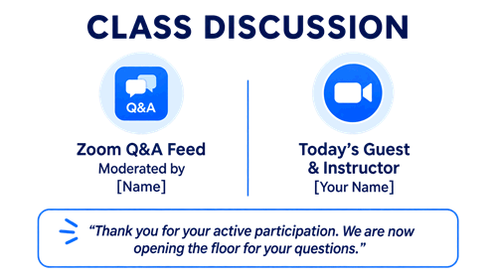
WORKBOOK
1. Download and open the workbook
2. Find the practical exercises or REFLECTIONS in each Module
1. Page 6
2. Pages 9 & 13
3. Page 15
4. Page 16
5. Page 19
If you have to miss a session you can make it up with the Workbook
Notes:
May I remind you the workbook is a complement of the sessions and a practical takeaway of the whole journey. It has content, practical exercises, and post-work.
Please review it section by section on your own time. The workbook is yours to keep and come back to.
Now, if you have not done so already please download the workbook and open it.
Now please find the practical exercises for each module, they are called REFLECTIONS. We will do this every day, find the reflection or exercise for the day in the workbook and give you time at the end of the session to do it. Today´s Reflection is on page 15.
I you miss a session you can make it up in the workbook and come the following day.
Without further ado, let´s jump into today´s session

Slide 6
Agenda
Framing Job Search
Why a Job Search Strategy
Job Search Strategy in Practice
Workbook REFLECTION _ Module 3
Notes:
This is the agenda for today, we are going to reframe what job search is, why you might need a job search strategy, and how to actually put into practice a job search strategy. Then you will have the chance to put it into action in the workbook.

Slide 7
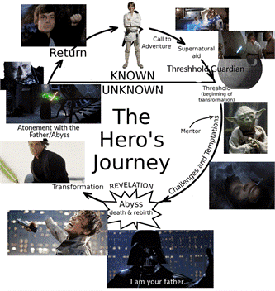
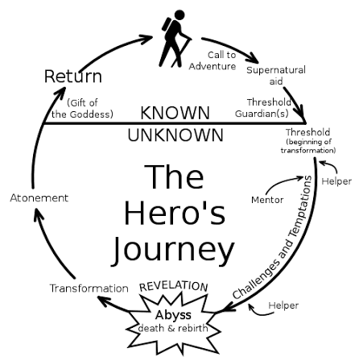
The Hero´s Journey
👉 Reference: Joseph Campbell— The hero with a thousand faces (3rd ed. 2008, New World Library)
Notes:
I want to begin with a framework that I think captures the emotional reality of career transition very well. Have you ever heard about the Hero´s Journey? It´s a very popular narrative structure for storytelling. A little bit like the Odyssey, if you were in the session yesterday. It´s the different stages a hero goes through: goes out into the world or receives a call to adventure, finds someone to help them, faces challenges, goes through a critical moment of death & rebirth, transforms and goes back home completely changed and ready for the next stage of life.
If there are any fans of Sci Fi here, this is the arch Luke Skywalker goes through in Star Wars. CLICK it might be easier to remember it this way.
Our lives are one big Hero journey, but also many smaller journeys. Every transition—personal or professional—is a small version of this same arc. Career transitions are no different. The stage of the journey we’re going to look at is the abyss, the death and rebirth stage—the peak of the crisis.
In coaching, we call this specific stage the threshold with capital T. It´s the threshold into our next self. It is the stage of liminality, from the Latin word limen, that literally means threshold. It is that uncomfortable space where you are no longer fully anchored in your old identity, but your new identity has not fully formed yet. You are no longer where you were, but not yet where you want to be. Think of a caterpillar, that goes into a cocoon for a while and then emerges as a butterfly.
But we are no caterpillars and us humans we don´t like change very much. Any transformation is painful for us and carries a very real sense of loss. For the person that you used to be.

Slide 8

Threshold Stage_Hero´s Journey
Looks great in movies, not so much in real life…
Notes:
In films, this stage looks beautiful. Think of Breakfast at Tiffany's—Holly struggling with herself in the cab and later standing beautifully in the rain. Or the hero taking long reflective walks, having some profound realization. Very poetic and cinematic. In real life, it rarely feels like that. It feels unsettling, messy, awkward, and deeply uncomfortable.
But liminality is not a problem to solve as quickly as possible, it serves a purpose. It´s actually the space where transformation happens. It creates the conditions for reflection, growth, and eventually reinvention. Because growth does not happen when everything feels clear, comfortable, and perfectly planned. Growth and transformation happens in discomfort and uncertainty. Not despite the mess—but because of the mess.

Slide 9
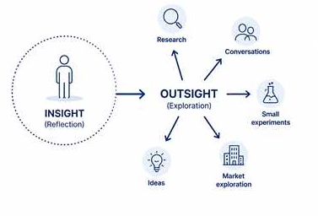
The Road Back – “outsight”_Hero´s Journey
👉 Reference: Herminia Ibarra— Working Identity (2023, Harvard Business School Press)
Notes:
So if liminality is such an uncomfortable place, how can we live in it? and how do we move through it?
This is where Herminia Ibarra’s work is very helpful, she is an organizational psychologist working in business schools. In her book Working Identity, she explains that most professionals try to think their way out of uncertainty. They believe they need full clarity before taking action, so they stay in reflection mode—thinking, analyzing, planning, trying to figure everything out before making a move.
But Ibarra challenges this completely and takes a page out of Design Thinking. And invites you to embrace the messiness.
Her argument is that insight alone is not enough. Reflection matters, of course—but at some point, you need what she calls outsight. Outsight comes from engaging with the external world, in small and low-risk ways: read a book, take a short course, attend an event, reach out to someone, or simply talk to someone who knows someone. Clarity comes from action—not before action.

Slide 10
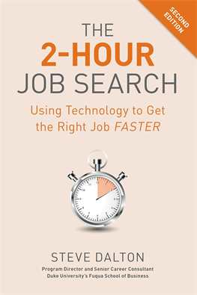
“The 2 Hour Job Search” Method
👉 Reference: Steve Dalton— The 2-Hour Job Search (2nd ed. 2020, Ten Speed Press)
Notes:
So take action, but action towards what? And this is where a job search strategy comes in. When you begin turning outward and testing the market for jobs, many people get stuck. They take actions that are not yielding the best results or that are inconsistent. Research from career transition experts and , social scientists all points to the same conclusion: a structured job search is efficient and psychologically good for you.
Because you are in this liminal, uncomfortable stage, you are operating from a place of emotional instability. One day you feel optimistic and apply to twenty jobs. The next day you feel discouraged so you stop applying. A week later you start up again, and then maybe you think you need another certification. Then maybe you decide your CV is the problem and rewrite it again. You stay busy—sometimes extremely busy with these actions—but busy does not necessarily mean effective.
Without structure, it becomes very difficult to stick with a strategy long enough to generate meaningful learning and consistent information. And if your inputs are inconsistent, your conclusions will be inconsistent too.
.This is why I favor Steve Dalton’s methodology The 2 Hour Job Search. His framework transforms job search from something reactive and emotionally draining into something structured, measurable, and repeatable.

Slide 11

Beyond Applications
“Applying online is like eating cereal with a fork
You may eventually get fed but it´s painfully inefficient”. Steve Dalton
If you want to know more about applications in private market and interviews, go to Career Transition Series webpage.
Notes:
One of the most important mindset shifts in this methodology is understanding that applying to jobs is not the same as having a job search strategy.
In the private market applications can be useful. They help you understand what roles exist, and how companies describe them. They are a source of market information. But relying on applications alone is like eating cereal with a fork. You may eventually get fed, but it is painfully inefficient.
This is a bit of a shock to UN and public sector professionals, applications are critical in your current space. Recruitment in the public sector is application driven.
But the private market is more relationship driven. Merit matters, of course, and meeting criteria, but not all of it is necessary. And with advent of AI, there are thousands of applications. The only way to prioritize many times is by relationships, and this means, yes, you know what´s coming: networking.
I hear the same concerns repeatedly: I don’t want to bother people. I don’t want to ask for favors. What if they don’t respond? All of these reactions are completely understandable.
Applying feels safer. It feels cleaner, more controllable, and less risky—even though it is far less effective.

Slide 12

Networking as the foundation
👉 Reference: Designing Your Career: The Networking Reframe— Stanford Life Design Lab (2017)
Notes:
The private sector operates very differently like we just said. merit alone is not enough. You need visibility and relationships. So you need to ask the experts, the active professionals that are working in these companies or organizations. This is called networking, and it´s very loaded word for many, it feels, at the very least, awkward. A much more useful way to think about networking is as asking for directions. So I´ll play a little video for you, keeping with the Design Thinking Mindset.
The goal is not to “do networking.” The goal is to become part of the network and get visibility on real opportunities for you.

Slide 13
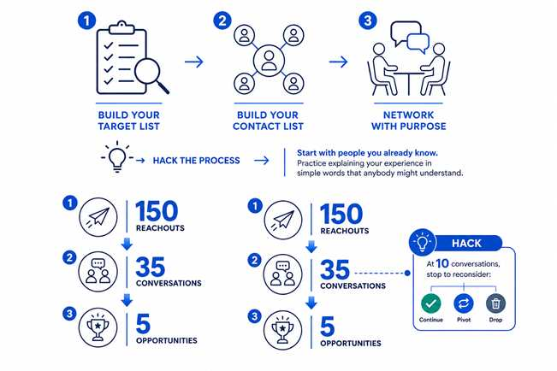
Job Search Building Blocks
Notes:
Once you understand why networking is important, let´s get you started on what a structured job search is. It is moving away from a reactive job applicating and toward intentional opportunity generation.
The first step is building a list of target companies or organizations and then you define your priorities in that list. So instead of trying to search the entire market, you narrow your attention to organizations where your profile could realistically create value.
The second step is building a contact list. These are the people inside—or around—those organizations who can help you better understand the company, the role, and the broader market.
The third step is networking in a focused way to generate information and, eventually, advocacy. These conversations help you validate assumptions, refine your positioning, improve your market understanding, and sometimes open doors that applications alone never would.
Now, this would be the sequence, but in practice there is room to adapt the approach—especially for UN professionals I recommend testing your private-sector “legs” so to speak, begin practicing how to talk about your experience in a way that anybody might understand. So you move away from UN agency language and into real-world language that is simple. You can take it one step further, how might you explain what you do to a 12 year old?

Slide 14
Network Funnel
Weekly tracker:
Amount of reach-outs
Amount of informational interviews
Notes:
Going deeper into the last block of generating conversations, I want to share an impactful metric that is successful and very tangible for job searchers. This is the single most powerful argument there is to convince you of this approach.
150 strategic reachouts lead to 35 informational interviews which in turn generate 5 real opportunities. These are the baseline numbers. By opportunities, I mean job interviews but also consulting projects, advisory roles, collaborations, and introductions to hidden opportunities.
This means that 150 reachouts to people you sort of know—through LinkedIn, mutual contacts, former colleagues, alumni, or friends of friends— realistically turns into 35 conversations, where you are building trust, credibility, advocacy, and eventually access to opportunities that are not even public.
This is why I find this framework so powerful. Some professionals are genuinely surprised when they start using it. I regularly have people come back to me saying, Teresa! This person agreed to speak with me—from this incredible company, or this foundation! This really works!
And I always tell them the same thing: Yes—I know. That’s exactly why I told you about this method.
And still, it never fails to amaze them.

Slide 15
Evidence-Based Pivoting
Notes:
The funnel is incredibly useful because it gives us measurable progress. But not all professionals should move through that funnel in exactly the same way. This is especially true for career changers and UN professionals navigating transitions.
For example, imagine a senior professional in supply chain targeting a sector they already know, in a market they have worked in for years. They have a super clear target. For someone like that, the challenge is mostly execution of the funnel, getting through the contacts.
However, when you are targeting a sector you barely know, or a market they have little experience in, it´s better to build in some milestones to reassess. To prevent you from either giving up too early or pushing too long in the wrong direction for you.
Build a target company list, start reaching out, and begin having conversations. I would recommend you stop at 10 conversations to assess. Is the target still good for you? After learning a bit more, is it still what you want or do you want something else?
And so you can decide, if you want to continue, if you want to change to something similar, or you want to drop that target altogether. And this is not failure. This is valuable market intelligence that helps you get closer to what you want.

Slide 16

UN Target list
List of 40 target companies AT LEAST
10 Dream companies/Organizations
Dream companies
5 competitors
Or adjacent companies
10 Alumni & Warm Networks
Alumni, former colleagues, friends, diaspora
10 Supranational bodies
Multilateral banks, supranational bodies, regional institutions
5 Consulting Firms
Impact consulting, strategy, ESG, public sector consulting
Notes:
We all can agree now: the first step is not applying—right? Right? Ok ☺ The first step is building a list of relevant organizations.
Dalton´s original framework, is called LAMP, but we are going to adapt it to UN professionals. So we will focus on five buckets that reflect how senior professionals actually transition.
List 10 dream companies, or companies that caught you eye. In this training or whenever. List 5 competitors of those companies. If you are interested in say Amazon, also think of competitors, providers, and consulting firms that support them.
List 10 companies in which there are Alumni from your school, former colleagues, university alumni, diaspora communities, and friends of friends.
List 10 public sector companies, because supranational bodies and development finance institutions are strong transition options for many profiles.
And finally list 5 consulting companies, particularly impact consulting and public sector advisory work.
The goal is to build a list of roughly 40 to 60 organizations: broad enough to create options, focused enough to act on.

Slide 17

Prioritizing UN Target List
Score 1-5
ACCESS Can you reach them?
MOTIVATION How interesting for you initially?
ALIGNMENT Is this a strong fit? Capability, compensation, culture fit.
Notes:
Once the target list is built, prioritize. I recommend using three variables: Access, Motivation, and Alignment.
Access measures how realistic warm outreach is. Can you reach someone through your existing networks?
Motivation captures willingness to invest your energy. This matters because motivation drives action.
Alignment brings together everything we covered in previous modules: capability fit, culture fit, and compensation fit.
This is where the sector framework becomes practical. A sector may sound attractive, but does it actually align with your strengths and requirements?
The objective is to prioritize intelligently and focus energy where momentum is most likely, so you start with the companies that have the highest scores on a excel spreadsheet for example.
We´ve built this into the UN tracker excel spreadsheet which is In the workbook, you will have time to find it later.

Slide 18
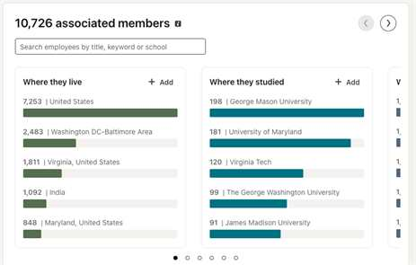
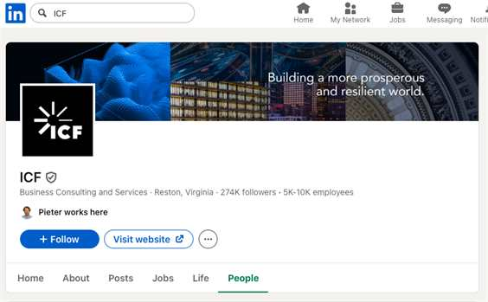
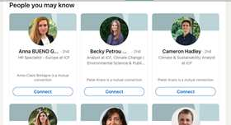
Finding Contacts For Your 40 Companies
Search LinkedIn
Notes:
Once the target list is built, the next step is identifying whom to contact.
LinkedIn is the most useful tool for this. This is why having a credible LinkedIn profile matters so much. If you do not have a LinkedIn profile, that´s ok, we´ll work on that tomorrow.
Before replying to your message or accepting your connection, people will almost always look at your profile. It needs to feel trustworthy, clear, and professional. Start by searching the company. Then check whether someone in your network works there. Its possible there won’t be a direct contact—and that’s completely normal.
Use the filters of geography, university, and language to find professionals that have those things in common with you. Shared language, shared geography, or shared educational background help create a real connection. Even if you do not know anyone, cold outreach is completely acceptable. The goal is not to find perfect contacts—it is to identify the people most likely to respond and help. I also recommend prioritizing business professionals over HR, unless the person themselves comes from HR.

Slide 19
6 Point Email_Outreach that works
State your connection
Dear Chris,
I saw you graduated from X.
I’m exploring innovation roles in a purpose driven environment and would love to hear about your experience in La Caixa’s innovation team.
Would you be available for a 20 min conversation?
Thanks for considering, warm regards,
Sarah
Define your interest specifically and generally
Concise (<100 words)
No mention job posting
Put a concrete ask as a question.
Do your ABC testing
Notes:
The 6-point email gives a practical structure for reaching out: start with a greeting, establish connection or common ground, explain why you are reaching out to this specific person, make a clear and simple ask, propose easy logistics, and close with appreciation. Secure a short conversation to get to know this person and their work better.
The message should be brief, because people are busy and often reading messages quickly on their phones. It should be human, because this is person-to-person communication, not corporate or sales messaging. Egoless, because this is not the moment for a long professional summary or a list of achievements. And sincere, because the goal is not to impress—it is to genuinely seek insight or to thank.
But my feeling is that you already know all of this… in these months UN professionals attending my sessions have reached out to me in a way that was beautiful. Polite, thoughtful, personal. And 9 times out of 10 just to say thank you and share a thought. You are great at this already.
MOST COMMON MISTAKE: mentioning recruitment or jobs too early. The moment you mention jobs, people think HR, and they will redirect you to the jobs section of the website or share the generic HR inbox. That is why the first outreach message should not be about getting a job. It should be about learning.

Slide 20
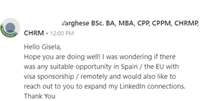
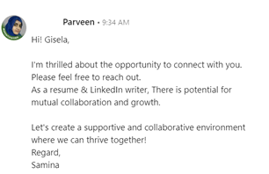

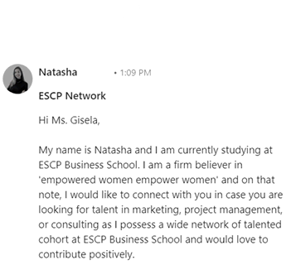
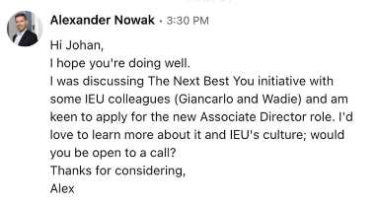
Other 6 Point Email Examples
Notes:
These are some examples you can take a look at later on.

Slide 21
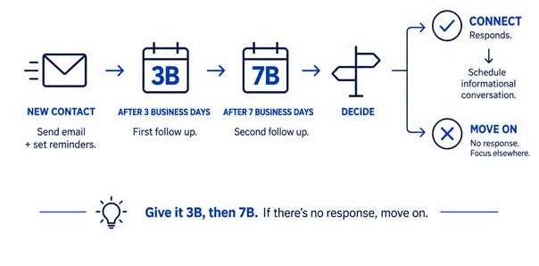
3B7_Follow-up that works
Notes:
Ok, so you have sent out 10 messages. Now what? There is a very simple rule for following up: follow up twice—once after 3 business days, and again after 7 business days.
This creates structure and helps you avoid overthinking. Instead of wondering, Should I follow up? Am I being annoying? Have I waited too long?—you simply follow the system.
If there is still no response after two follow-ups, move on. Not everyone will respond—and that is completely normal. Silence does not mean rejection, and it certainly does not mean something is wrong with you.
Supposedly there are three categories of contacts.
First, Boosters. These are people who can help and genuinely want to help. These are your ideal contacts.
Second, Obligates. These are people who may not be naturally enthusiastic about helping, but they do not want to appear unhelpful, no one likes looking bad. They may respond, but the might be evasive, or they make it just too hard to schedule a call with them. Move on from these people, they are usually not able or willing to help.
Third, Non-responders. These are people who cannot help, are too busy, or simply do not want to engage.
And that is perfectly fine. Your goal is not to convince everyone to engage. Your goal is to systematically identify the people who are willing to help and focus your energy there.

Slide 22

What Informational Interviews Really Are
👉 Reference: Designing Your Career: The Informational Interview— Stanford Life Design Lab (2017)
Notes:
Once you are set up to speak to people, remember informational interviews serve two important purposes. First and foremost, they are learning conversations. And the second dimension is that through these conversations, you encounter someone who genuinely wants to help and is also in a position to help. This might be someone who can recommend you internally, flag your profile, introduce you to a hiring manager, or point you toward an opportunity you would not have seen otherwise. Informational interviews are a way to create access and advocacy.

Slide 23
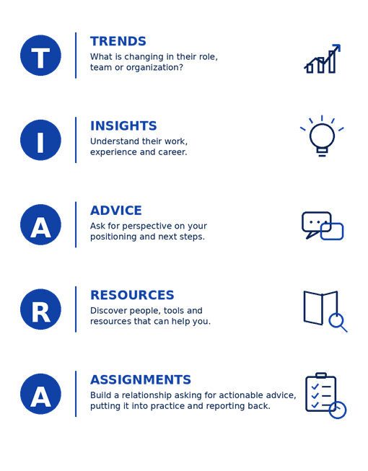
TIARA Framework
Notes:
Once the conversation starts, the next question becomes: what should we actually ask? I find this piece particularly interesting and easy, I am naturally very curious and I have scores of questions to ask in every situation. But if you are unsure of what to ask or how to structure the conversation I find Steve Dalton´s TIARA framework very easy to follow and it sets you up to have an interesting and productive conversation for both parties involved
What makes TIARA particularly powerful is the categories of questions and the sequence. You begin with Trends, asking broad questions about the industry, company, or market. This helps warm up the conversation and gets the other person talking comfortably. Then you move into Insights, which are often some of the most valuable questions in the entire framework. These questions invite reflection and prime creativity. They help people think more deeply about what really matters in their work, what drives success, and what they have learned.
This sequencing matters because by the time you reach Advice, the conversation is much richer. If you ask for advice too early, you can get generic answers. But if you first prime the conversation through trends and insights, the advice becomes far more thoughtful and specific. This is where you ask the powerful question: If you were me, what would you do next?
Resources is where you ask for concrete sources of information that can help you deepen your understanding. Rather than asking directly for referrals, I recommend asking about newsletters, LinkedIn groups, industry publications, communities, or thought leaders they find genuinely useful. OR if you already have trust, you can ask “Would you be comfortable introducing me to someone in this department that you are mentioning so I can ask them these questions?. This usually generates much more practical and useful guidance.

Slide 24
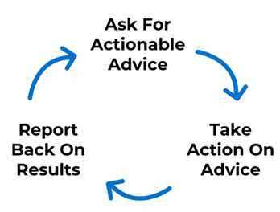
Following up after TIARA
THE ADVICE TRIANGLE
‘Can you introduce me to anyone who could offer further perspectives?’
‘Do you think it’s better to take Coursera Product Manager course or read ‘x’ book?
Notes:
The second A—Assignments— is about creating a natural reason to follow up and continue building the relationship. The ideal sequence is simple: ask for advice, act on the advice, then follow up to share what happened and ask for guidance on the next step. This creates a powerful loop. It keeps the relationship alive, keeps you top of mind, and gradually builds trust over time. Set up alerts to follow-up every month or every 2 months depending on your timeline. And keep them in the loop about your progress and any news you may have to share.

Slide 25
Track The Process & Progress
What gets tracked gets managed:
1. Target companies/orgs
2. Contacts names
3. Outreach messages
4. Follow-up schedule
5. Informational interviews
Download UN Transition Tracker in your Workbook page 15.
Use online tool such as: https://app.tealhq.com/home
https://huntr.co/
Notes:
The moment you get into the informational interviews, things get very complex very fast. You forget whom you contacted, when they followed up, who responded, or what was discussed.
Tracking solves this. At a minimum, you should track five things: your target company/organization list, contact list, outreach attempts, follow-up schedule, and informational interviews. This creates visibility into where you are in the process and where bottlenecks may exist. Are you stuck at targeting? Are you reaching out but not getting responses? Are you having conversations but not generating follow-up? Tracking makes these issues visible and fixable. For instance, if you are reaching out but no responses you might have to change your outreach message a bit.
The tool itself matters much less than consistency. Some of you will prefer a simple Excel tracker. Others may prefer tools like Teal or even a personal CRM. The important thing is having a system that keeps the process visible, structured, and manageable. We have made a standard excel tracker for you, it is going to be part of the exercise today.
OK, this was very intense and I want to move on to a space to reflect.

Slide 26
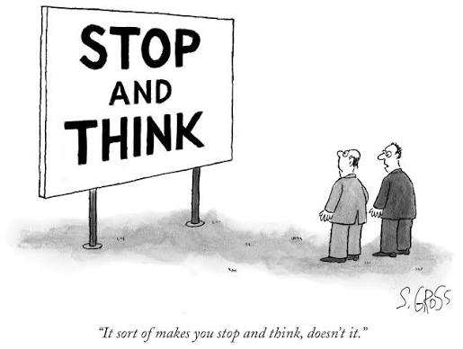
The session will be recorded. The recording and presentation will be available on: Career Transition Series webpage.
Sam Gross/The New Yorker Collection/The Cartoon Bank; © Condé Nast
Notes:
At this point, we have covered a lot of information. Please know the session will be recorded and shared. Slides will be ready by tomorrow and the recordings by next week. We need time to work our magic!
With this in mind I want to give you some time to breathe, think, and ask questions in the Q&A.
but we are not going into the Q&A just yet, first we have some work to do

Slide 27


WORKBOOK _ PAGE 15
REFLECTION_MODULE 3
Turn to page 15 of your Career Transition Workbook
Notes:
Now do this for yourself in the workbook. Please open your workbooks and turn to page 15, look for the red pin, with the title REFLECTION next to it. I´ll give you a minute to do that.

Slide 28
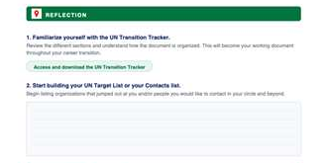
REFLECTION_MODULE 3
Turn to page 15 of Career Transition Workbook
Notes:
Notice there are 2 exercises. Exercise 1 asks you to access to UN Transition Tracker we´ve built for you. Engage with it, peruse it. It has all of the elements we discussed in this session. And Exercise 2 asks you to get started with your target company/organization list and or your contacts list. If you are ready to input into your UN Transition Tracker perfect, if not, you can input in the workbook first so you might feel more freedom to experiment at this point.

Slide 29


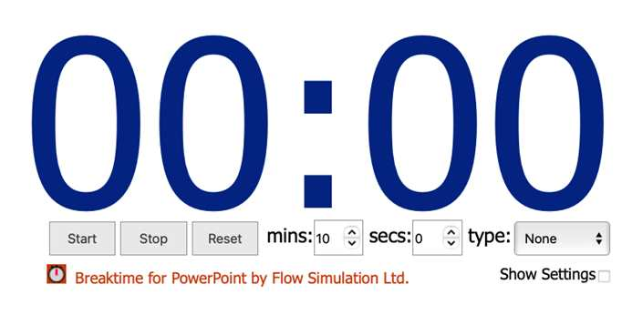
REFLECTION_MODULE 3_ PAGE 15
KEEP YOUR OWN TIMING_10 MIN TOTAL
“Ghostwriter” RJD2
If you have time to spare you may start with Continue Your Journey questions directly below
Notes:
You have 10 minutes for these exercises. Instructions are in the workbook.
GO TO SLIDESHOW MODE
WAIT UNTIL CLOCK RUNS OUT
GO BACK TO PRESENTER MODE

Slide 30
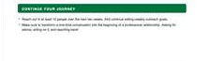
Post-work or homework
CONTINUE YOUR JOURNEY
Scroll down page 15 of your Career Transition Workbook
Notes:
For next steps, I want to suggest you complete the exercise in CONTINUE YOUR JOURNEY on the following page.

Slide 31
Q&A_Mapping the Private Sector
TERESA CALLEJO
ROSA YLIMAULA
UNOG

Slide 32
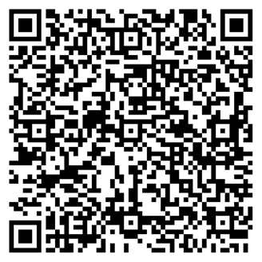
Survey Form
Let us know your thoughts about the session!​
👉 Click here or scan the QR code.

Slide 33
Coming up tomorrow:
CAREER TRANSITION READINESS PROGRAMME
DAY 1. MAPPING THE PRIVATE SECTOR
DAY 2. DESIGN THINKING YOUR CAREER
DAY 3. JOB SEARCH STRATEGY
DAY 4. APPLICATION MATERIALS
DAY 5. COMPENSATION
HOMEWORK: Complete Continue Your Journey questions on Workbook page 15

Slide 34

Thanks for your participation!
Notes:
In light of the evolving organizational landscape across the UN system, building on the UN80 reform agenda’s emphasis on transformation and collaboration, UN Geneva, UNDP, UNHCR and IOM have launched the Career Transition Series: Pivoting Outside the UN System.
This inter-agency initiative responds to the growing need for practical career transition support, helping UN personnel navigate change and explore professional opportunities in the private and non-UN sectors.
Beyond the UN: Global Career Opportunities
Exploring Professional Pathways Beyond the UN System
An inter-agency career transition initiative
Jointly led by IOM, UNOG / UN Secretariat, UNDP, UNHCR and WHO
With technical and operational support from Global Careers
In light of the evolving organizational landscape across the UN system, building on the UN80 reform agenda’s emphasis on transformation and collaboration, IOM, UN Geneva, UN Secretariat in New York, UNDP and UNHCR are launching the Career Transition Series: Pivoting Outside the UN System. This inter-agency initiative responds to the growing need for practical career transition support, helping UN personnel navigate change and explore professional opportunities in the private and non-UN sectors.
Whether you are directly affected or proactively planning your next steps, this series will provide you with practical tools, expert insights, and the confidence to successfully pivot in today's evolving job market.

