Slide 1






WELCOME!
CAREER TRANSITION READINESS PROGRAMME
5 MODULES IN 5 DAYS

Slide 2



Zoom - Housekeeping rules
You are muted by default. The chat function is disabled.​
If you have any questions, please submit them through Zoom Q&A button.​
The session will be recorded. The recording and presentation will be available on: Career Transition Series webpage.

Slide 3

Teresa Callejo
Career Strategy & Development
10+ years helping global professionals gain clarity & confidence:
Navigating growth in transitions
Translating UN experience into market value
Notes:
For those of you joining today. My name is Teresa Callejo.
I'm an HR professional with a background in Talent Acquisition, Headhunting and Professional Development.
Over this series I am hoping to lend you my recruiter glasses to help you understand how the private sector thinks, how hiring works, where your experience might fit, and how you can start navigating that transition.

Slide 4
CAREER TRANSITION READINESS PROGRAMME
DAY 1. MAPPING THE PRIVATE SECTOR
DAY 2. DESIGN THINKING YOUR CAREER
DAY 3. JOB SEARCH STRATEGY
DAY 4. APPLICATION MATERIALS
DAY 5. COMPENSATION
5 DAYS INDEPENDENT CONTENT /1,5 HOURS PER DAY
7,5 HOURS YOU INVEST IN YOUR TRANSITION
1 TAKE AWAY WORKBOOK + RECORDINGS
Notes:
We are aware that this programme is a significant investment of your time, and we do not take it lightly. The sessions are 1 hour and a half every day for five days.
Today is Day 2, we're going into one the most interesting creative methodologies which is Design Thinking, as it applies to your career.
Tomorrow, on Wednesday, which is Day 3, we'll turn that exploration into an actionable job search strategy. Thursday, Day 4 is about how you position yourself through your application materials, your CV and your LinkedIn. And on Day 5, we'll look at compensation and salaries in the private sector.
There is a logic to the sequence, but don't worry if you have to miss a session.

Slide 5


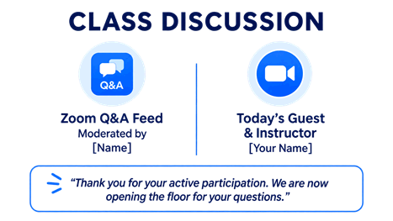
WORKBOOK
1. Download and open the workbook
2. Find the practical exercises or REFLECTIONS in each Module
1. Page 6
2. Pages 9 & 13
3. Page 15
4. Page 16
5. Page 19
If you have to miss a session you can make it up with the Workbook
Notes:
May I remind you the workbook is a complement of the sessions and a practical takeaway of the whole journey. It has content, practical exercises, and post-work.
Please review it section by section on your own time please. The workbook is yours to keep and come back to.
Now, if you have not done so already please download the workbook and open it. It is being shared continually in the chat by the team so you can download at any time.
Now please find the practical exercises for each module, they are called REFLECTIONS. We will do this every day, find the reflection or exercise for the day in the workbook and give you time at the end of the session to do it. Today´s Reflection is on pages 9 and 13.
Without further ado, let´s jump into today´s session

Slide 6






DAY 2 AGENDA: Design Thinking Your Career
Brief introduction to Design Thinking
3 different career scenarios
Next steps you may take to test your career scenarios
To work on in your Workbook
Notes:
We are going to go over what Design Thinking is, experience it through activities, and you will walk out of this session today with 3 different life and career scenarios and actionable next steps to test them out in real life.

Slide 7


DESIGN THINKING
IDEATE
ACCEPT
DEFINE
PROTOTYPE
REFLECT
EMPATHIZE
TEST
Notes:
What is Design Thinking? Design thinking is a human-centered, iterative process used to solve complex problems by prioritizing the needs of real people. It is one of Stanford University´s flagship programs that has been replicated in many other universities and in many companies use for designing customer journeys and proposals.
Design Thinking is a process that is Non-linear: You can repeat, reorder, or revisit phases at any point as new insights emerge.
Collaborative: bringing in diverse teams to spark better innovation.
And action-oriented: Focused on learning by doing and rapid experimentation rather than endless planning
We are going to look at 2 phases today, the most representative of the methodology, IDEATE AND PROTOTYPE so you can practice both.
Ideating or Brainstorming the widest range of creative, out-of-the-box solutions without judgment.
Prototyping which is Building simple, scaled-down versions of the best ideas to see whether they are viable

Slide 8


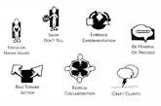
Design Thinking Mindsets
CURIOSITY
REFRAMING
BIAS TOWARD ACTION
RADICAL COLLABORATION
Look through the lens of curiosity not judgement
Enable looking at problems differently for innovation
Commit to build your way forward. Test and fail often
Solutions emerge from diversity and the courage to share
Notes:
Designers have a way of thinking that really sets them apart. I want you try on a Designers hat and really own the main mindsets of a Designer
I invite you to be curious: Curiosity invites exploration without any judgment or rushing to solution.
I invite you to reframe: Reframing enables designers to examine ways to look at problems differently.
I invite you to lean into the action. Bias Toward Action is the heart of design thinking; Designers try things, they test out ideas, and they fail often. There is no judgement here either.
And I invite you to collaborate. Design is a collaborative process and and many of the best ideas are going to come from working with other people.

Slide 9
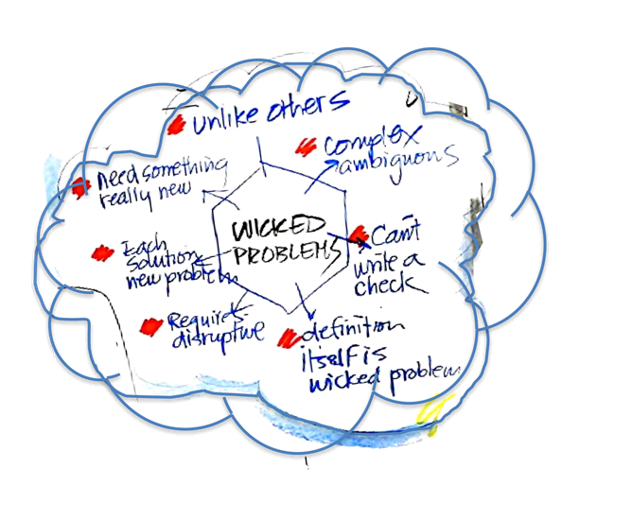
DESIGN THINKING is…
… a good approach to WICKED PROBLEMS
… and life is a big one!
No definitive formulation
No stopping
Solutions are not true or false
Richard Buchanan, Wicked Problems in Design Thinking (1992)
Notes:
You use Design Thinking to navigate what is called "wicked problems"—problems that are complex, shifting, and that lack a single definitive solution. And what is life if not one big wicked problem!
The scope of your life changes continually, there is objective stopping point where you are "finished" or have a final "correct" answer, and Solutions for your cannot be proven right or wrong analytically, they serve you at a moment in time and then have to change.

Slide 10

Design Thinking:
helps you figure out
what you want to grow into
as your life unfolds.
Notes:
Design Thinking helps you figure out what you want to grow into as your life unfolds. This is probably the single most compelling argument for me. That you can grow continually, and that life is not some sort of ticking clock but an unfolding event full of complexity.

Slide 11
IDEATE
ACCEPT
DEFINE
PROTOTYPE
REFLECT
EMPATHIZE
TEST
Notes:
Let´s start with IDEATE Ideating or Brainstorming the widest range of creative, out-of-the-box solutions without judgment.

Slide 12

IDEATE
LET’S…
Notes:
And what better way to start than with a practical demonstration. Let’s jump in and do something
Are you ready for your first design exercise?

Slide 13

IDEATE
“HOW MANY USES?”
List all the things you might use a paper clip for.
Go for as many ideas as you possibly can.
You have 3 minutes…
Notes:
THE ACTIVITY IS List all the things you might use a paperclip for.
Get a notebook or piece paper and something to write with. It can also be your phone or your computer.
Go for as many ideas as you possibly can. No judgment, no big deal, just write as many uses for a paperclip as you can think of.
3 minutes on the clock!

Slide 14

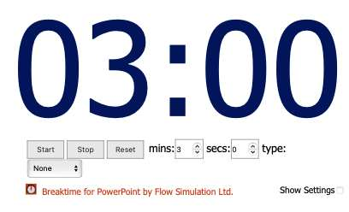
IDEATE
“HOW MANY USES?”
List all the things you might use a paper clip for.
Go for as many ideas as you possibly can.
You have 3 minutes…
“Flight of the Bumblebee” Nikolai Rimsky-Korsakov
Notes:
3 minutes on the clock start now
GO TO SLIDE SHOW NOW
LET TIMER RUN
GO BACK TO PRESENTER VIEW WHEN FINISHED

Slide 15

IDEATE
Notes:
Alright, pens and pencils down.

Slide 16
IDEATE
Welcome back!
How was the experience?
How many ideas did you have?
10
10 to 20
More than 20?!
Did you get stuck?
Did you get unstuck?
Notes:
Welcome back! How was that?
How many uses did you come up with? less than 10, from 10 to 20 or more than 20. You are all incredible for trying. My best mark was 5, that´s how many uses I could find when I did this little exercise.
I really admire you if you were able to think of more than 20 uses for a paperclip.
Were you ever frustrated or stuck?.
Did anyone get unstuck? Like you hit a wall , and then all of a sudden a light bulb went off and a new ideas came pouring out?

Slide 17
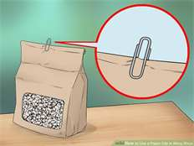


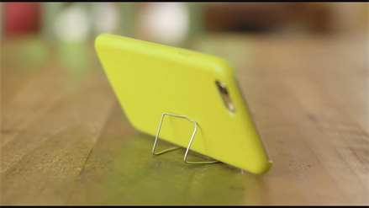
IDEATE
SCHEMAS
PAPER CLIPS TO HOLD THINGS
Notes:
It turns out our brain organizes data in the environment hierarchically, in what cognitive psychologists call schemas. It’s our brain wanting to be efficient in interpreting the vast amounts of information we are presented with in the world.
And here’s a secret: I primed you for a certain, schema. I showed you on screen an image of a green paperclip holding sheets of paper together, so doing it´s typical function. And I of course primed you for pressure! Hence the music urging you to go fast.
I influenced you to think in a pathway of ideas. So perhaps, you started out with ideas in the “holding things together” schema:
holding a tube of gift wrapping paper,
or holding a bag of popcorn closed,
or holding photo prints, if you were feeling creative
using it to hold up your phone.

Slide 18
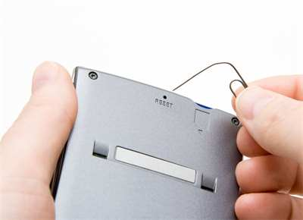
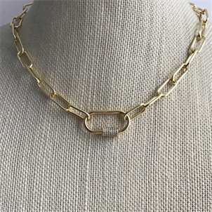
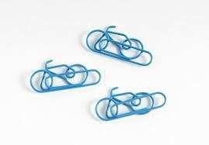

IDEATE
SCHEMAS
PAPER CLIPS AS TOOLS
PAPER CLIPS AS JEWELRY
PAPER CLIPS TO HOLD THINGS
PAPER CLIPS AS ART
PAPER CLIPS FOR REPAIR
Notes:
So, maybe, when you thought of a paperclip as something to hold up your phone, maybe you realized a paper clip can be used as a tool… Like using the point of a paperclip to reset your router or open your phone sim card. And tools might make you think of an “adjacent schema” – repair, like using a paperclip as a zipper in need of repair. And having it on your clothes might make you think of things you wear, leading to another “adjacent schema”… jewelry. And the jewelry schema might lead you to think of paperclips as art.

Slide 19
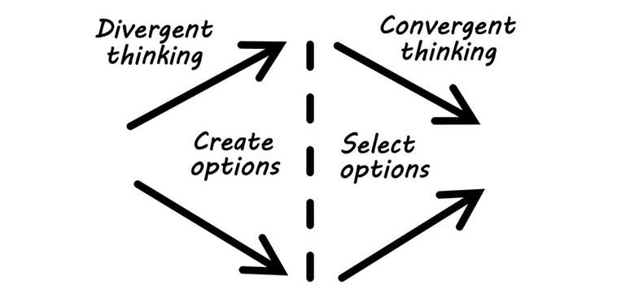

IDEATE
SCHEMAS
?
RADICAL COLLABORATION
Notes:
So what does this concept of schemas, have to do with Life Design? There’s an old saying “When all you have is a hammer, every problem looks like a nail” So, if you can be aware of your schemas, you can interrogate them and intentionally take a different POV, so you access to a broader set of ideas from which to design.
Divergent Thinking is the ability to generate many ideas or solutions from a single idea or piece of information. It’s thought to be one of, if not the most, important factor in creativity. But it’s a mostly ignored skill because in school and most workplaces, we’re taught and encouraged primarily to practice Convergent Thinking, which is the opposite: to take many pieces of information or data and generate one solution.
By now, I think you already know Design Thinking encourages divergent thinking so you can have a broader set of possibilities for your choices.
Let´s look at a little story for a minute.

Slide 20

STOP TO THINK
What did you want to be when you were a kid?
Why?
?
Notes:
You know who is very good at divergent thinking? Kids. Remember, what did you want to be when you were a kid? And why?
I wanted to be a short story writer. And my sister wanted to be a professional instalator of posters. There might be astronauts in the room, ballerinas, sports players...

Slide 21

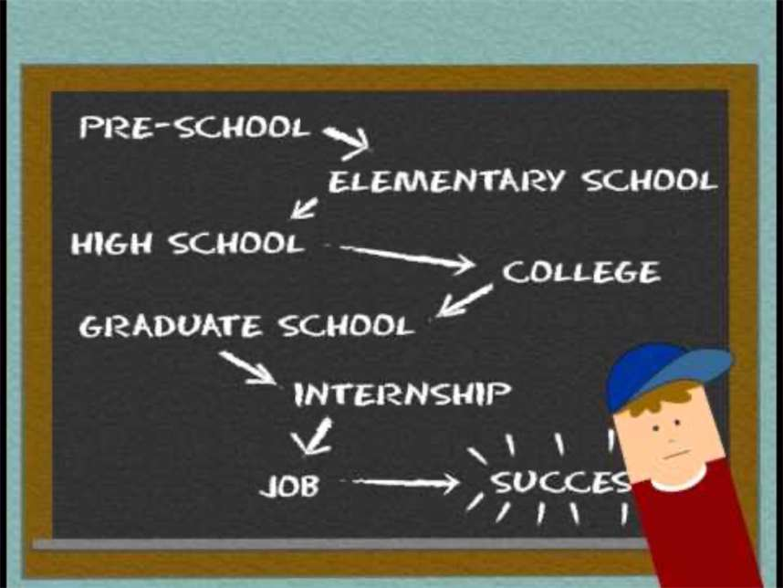
Alan Watts, Life and Music (circa 1970).
South Park creators Trey Parker and Matt Stone, animated short (2008)
Notes:
I want to show you a video animated by the creators of Southpark, it´s based on a speech made by philosopher Alan Watts. Since it´s a recording from the 1970s the sound is not the best, please bring up the volume on your computer.
https://www.youtube.com/watch?v=6I2pcIbyq-0&t=18s

Slide 22
STOP TO THINK
What story did you get about the way things work growing up?
How have these ideas failed you and served you?
?
Notes:
Think for a minute, what story did you get about the way things work, growing up? How have these ideas failed you and served you?
Is the story you got like the one in the video? like there was a serious purpose at the end of life? or was it more the singing and dancing?

Slide 23
Think back to the end of high school, just before going to university?
IDEATE
DYSFUNCTIONAL BELIEFS
What did everyone say to you?
“Oh, how wonderful! These are…
Notes:
To give you an example, of ideas about how things work. Some of them might be great and others… not so much. They are called dysfunctional beliefs.
I have an example of a very typical dysfunctional belief: Do you remember back when you got into college? When you were accepted into university and everybody congratulated you.
They said “Oh how wonderful! These are…”

Slide 24
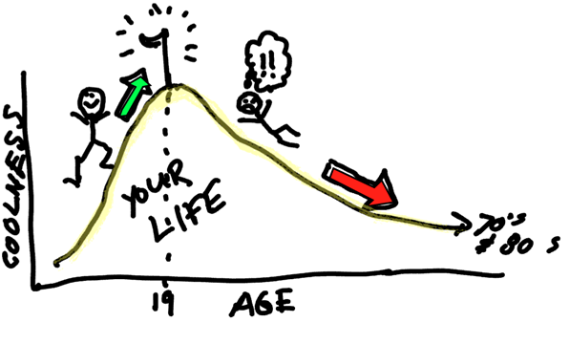

IDEATE
…the best years of your life!”
Notes:
The best years of your life!” And you quickly imagine that this part of life is going to be great, but then it´s all downhill from there.
It’s a horrible prospect!
So we can use reframing to turn a dysfunctional belief and turn it around.
Aha, this is a much better graph! (click)
Life continues to be meaningful well into old age, you continue growing and learning... There will be hardships, but there will also be joy.
For me, college and grad school were great but being 42 is even more awesome!

Slide 25

IDEATE
OTHER DYSFUNCTIONAL BELIEFS
‘You should know where you’re going by now!’
Notes:
Here’s another one – you should know where you are going by now! I felt this all throughout my 20s and 30s, my parents and society put an emphasis on “having it figured out” with the implication that after a certain point you are running behind, that you should have THE CAREER, THE LIFE fixed at 30 and expect no change.
Nowadays people are building lives that are far more fluid and changing. You can have more than one spouse or none at all, children or none at all, one career or several, and as life expectancy goes up to 100, we are not going to just have the 1 job we retire from and be done, but more fluid collaborations.
So the idea that there would even be a static “figured out’ that we are late for is false just making us feel bad.

Slide 26
THE ODYSSEY
IDEATE
ACCEPT
DEFFINE
PROTOTYPE
REFLECT
EMPATHIZE
TEST
Notes:
Let´s go into another ideation exercise. The Odyssey is an ancient Greek poem, it´s hero´s quest and journey back home after the Trojan war. There was a movie this summer called the Odyssey by the way, so should be fresh on people´s minds. What serves us from the Odyssey in this session is it´s personal character, the lone hero that is set on a winding path full of challenges to overcome.
I have 3 qustions for you now.

Slide 27
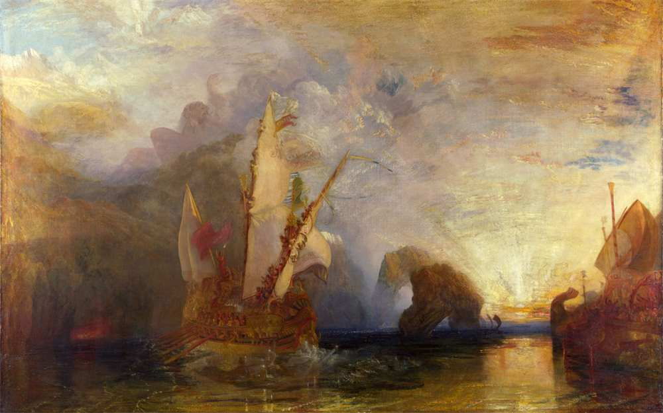
CAREER SCENARIOS: ODYSSEYS
IDEATE
1
What is your story?
William Turner, Ulysses Deriding Polyphemus (1829) The National Gallery
Notes:
I call on you today to imagine yourself as Odysseus for a little while, and think of your story. If your life were an epic poem, what would your story be?
Let´s imagine you are the hero of your own life. Maybe there are no giants or greek gods in your story but you are still a hero!
What are your goals, your struggles, your milestones into the future? Where do you see yourself going?

Slide 28
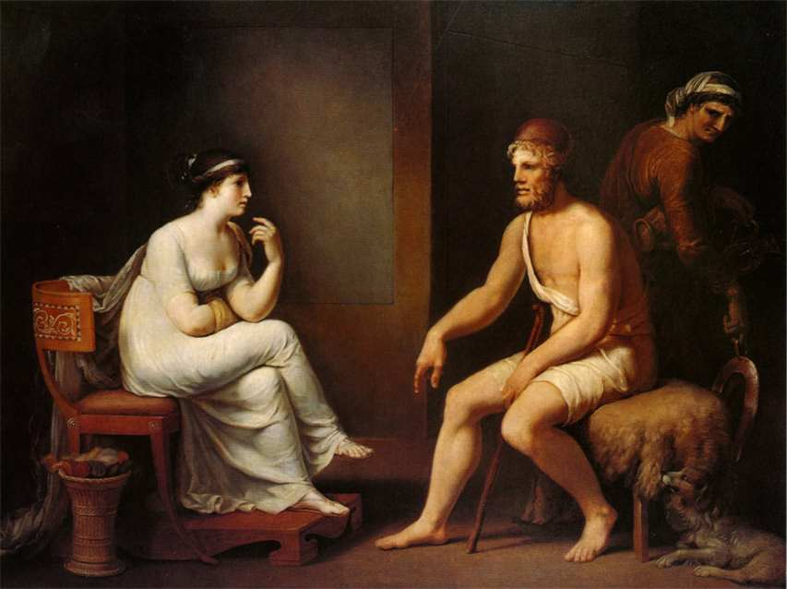
IDEATE
2
What if you had made different choices? Or your story was not possible anymore?
Wilhelm Tischbein, Odysseus and Penelope (1802) Private collection
Notes:
Now imagine you made a completely different decision in a turning point. What would that story be like? Imagine the epic poem that would make. If for whatever reason you could not carry on living where you are living, or working where you are working. What if your current life was not possible? What if you had an alternate life.
If Odysseus had never left home, had not gone to the Trojan war, he would have led a very different life. Maybe a very domestic life with his wife Penelope like you see on the screen.

Slide 29

IDEATE
3
What if you had complete freedom to choose?
www.istockphoto.com/es/fotos/freedom-of-choice
Notes:
And now imagine, what if you had complete freedom of choice. If money was not an object or if status was not important? What wour life be like?
If your life were not an epic poem, or a regular life at all? If it was a song or a video game, if you had unlimited funds and unlimited support to do whatever you chose, and if you did not care about your status, or your image.
What would that life look like? what would your story be like?

Slide 30



IDEATE
LIFE & CAREER SCENARIOS: ODYSSEYS
The story you tell today
Wild idea!
If $$$, Image, Status did not matter
What if the option 1 wasn’t an option anymore?
Notes:
I invite you to imagine and put into writing these 3 alternate lives you might have. These 3 possible odysseys that you can look into today.
The story of your life you tell today, an alternate life if your current life was not an option or made a different choice, and finally, the life you would lead if you had no constraints, if money, status and perception did not matter at all.

Slide 31
WORKBOOK _ PAGES 10, 11 & 12
REFLECTION_MODULE 2
Turn to page 10, 11 & 12 of your Career Transition Workbook
Notes:
Please open your workbooks and turn to page 10, look for the red pin, with the title REFLECTION next to it. I´ll give you a minute to do that.

Slide 32
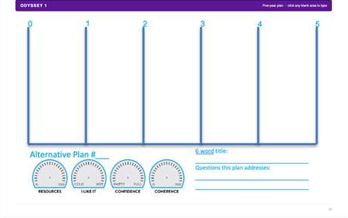
REFLECTION_MODULE 2
Turn to page 10, 11 & 12 of Career Transition Workbook
Notes:
Notice there are 3 blank Odyssey plans for you to draft your 3 Odysseys. Page 10 is Odyssey 1, page 11 is Odyssey 2, and page 12 is Odyssey 3.
If you would rather use a piece of blank paper to do this you absolutely can, because that way you can draw, doodle or color.

Slide 33
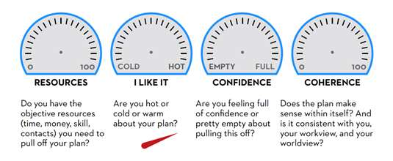




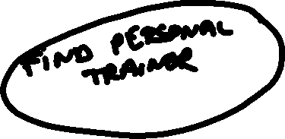


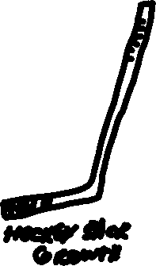

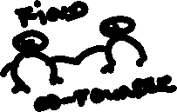
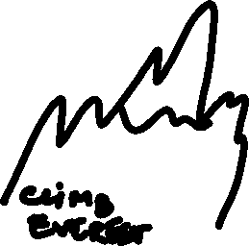






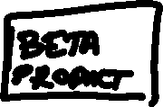
0
1
2
3
4
5
Alternative Plan #___
6 word title:
__________________________
Questions this plan addresses:
__________________________
__________________________
__________________________
Design Your Life book by Bill Burnett & Dave Evans, p.102
Notes:
Let me show you an example on paper, just a glimpse, this is my radical Odyssey 3. If money and status and convention were not a problem I would give tech entrepreneurship a try, and I would do it in Silicon Valey no less. Ha! I am very proud of my 3rd Odyssey. Are you ready for yours?

Slide 34
TIMELINES
Major Milestones
Professional & personal (bucket list)
At least one per year
0
1
2
3
4
5
6 word title:
__________________________
Questions this plan addresses:
__________________________
__________________________
__________________________
Alternative Plan #___
3-6 WORD DESCRIPTIVE TITLE
DASHBOARD
QUESTIONS
What questions does this plan raise?
Notes:
To fill out the Odyssey plan, your have 5 vertical spaces, each vertical space is 1 year, for you to write down major milestones, personal and professional items you have planned for yourself.
You start in the first block, between the first 2 lines. and the next blocks are the following years.
You may give it a title, it can be The Life I have Today, or Living my best life, or whatever
The dashboard is for you to gauge how coherent this odyssey is for you, your confidence in that it will work and the resources you may secure for it.
And there is a space to write down questions this Odyssey might raise for you.

Slide 35


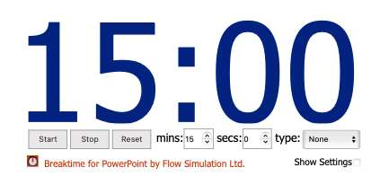
REFLECTION_MODULE 2_ PAGES 10, 11 & 12
KEEP YOUR OWN TIMING_5 MIN PER ODYSSEY
“Una Mattina” Ludovico Einaudi
Your 3 Odysseys
Notes:
You have 15 minutes total to do your 3 Odysseys, approximately 5 minutes per Odyssey. It´s ok if you do not finish completely.
Instructions are on screen and on the workbook.
GO TO SLIDESHOW MODE
WAIT UNTIL CLOCK RUNS OUT
GO BACK TO PRESENTER MODE

Slide 36
WELCOME BACK!
How was the experience?
IDEATE
What did it feel like to draft your Odysseys?
Did you find something unexpected?
Notes:
Welcome back! what did it feel like to do the Odysseys. Did you find something unexpected? How was that? I hope interesting, I see concentrated faces in our audience.
And now, let´s see if we can put the Odysseys or elements of the Odysseys into action.

Slide 37
Prototype
IDEATE
ACCEPT
DEFFINE
PROTOTYPE
REFLECT
EMPATHIZE
TEST
Notes:
Let´s look more closely at PROTOTYPING which is Building simple, scaled-down versions of the best ideas to see whether they are viable
perhaps you might prototype somethings from your odyssey. Prototyping

Slide 38

PROTOTYPE:
PROTOTYPE
MAXIMUM LEARNING with minimal investment
Avoid analysis/paralysis
Test your assumptions
Notes:
Prototyping is by far one of my favorites sections, and this is something that you will see consistently in the program and in the workbook, the only way to learn is to DO.
A prototype is a small, actionable thing you can do to gather information, test your assumptions and avoid the all famous analysis/paralysis. So don´t just wonder what something might be like, test it out quickly and drop it if it´s not a fit. That way you don´t waste your time and energy.

Slide 39


Career Prototypes
PROTOTYPE
LEARN BY LISTENING
LEARN BY DOING
  prototype conversations
  prototype experiences
Notes:
Mostly you prototype in conversations and in experiences, and I want to show you an example.

Slide 40

PROTOTYPE
Baby-sit for your niece or nephew
Volunteer at Adoption Shelter
Work as a dog sitter
How might I prototype having a dog?
Walk every morning & evening for at least 30 min regardless of weather
Walk on all fours around your apartment

Slide 41
PROTOTYPE
Eat poorly cooked fish
Spend a weekend on a boat
Expose yourself to extreme cold
How might I prototype sailing to Antarctica?
Eat canned food for a week
3D/Imax movie of Antarctica
Notes:
How might I prototype sailing to Antartica? I really want to do this, but before I spend my money and my summer on something that sounds nice, let´s see if I really want to sail to Antartica or not…
I can start by spending the weekend on a boat, actually experience being cooped up and sleeping in a rocking boat.
Then I can see how I will feel with the cold, maybe I can visit Greenland first?
Then I can try eating the sort of food I will have on a boat, coming from a can or fish that I might catch.
And finally perhaps going to see a 3D movie to get a sense of the sights.

Slide 42
WORKBOOK _ PAGES 13 & 14
REFLECTION_MODULE 2
Turn to pages 13 & 14 of your Career Transition Workbook
Notes:
Now do this for your self in the workbook. Please open your workbooks and turn to pages 13 and 14, look for the red pin, with the title REFLECTION next to it. I´ll give you a minute to do that.

Slide 43
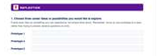
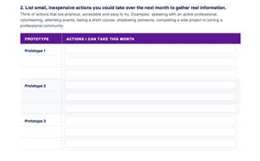
REFLECTION_MODULE 2
Turn to pages 13 & 14 of Career Transition Workbook
Notes:
Notice there are 2 exercises. Exercise 1 asks you to choose 3 things you might want to prototype. These items can be from your Odysseys or from any career idea you might have or has come up today. Exercise 2 asks you to do a list of small inexpensive actions you could take in the next month to test the prototypes. TO see if you want to pursue them or drop them. Gather information quickly to get good enough results.

Slide 44

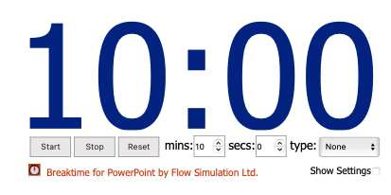
REFLECTION_MODULE 2_ PAGES 13 & 14
KEEP YOUR OWN TIMING_10 MIN TOTAL
Theme song from movie “Eternal Sunshine of the Spotless Mind”
1. How might you prototype… 1 to 3 things you are curious to test.
2. List small, easy actions to test the prototypes
Notes:
You have 10 minutes to fill in the exercises. Instructions are in the workbook, and on the screen FYI.
GO TO SLIDESHOW MODE
WAIT UNTIL CLOCK RUNS OUT
GO BACK TO PRESENTER MODE

Slide 45
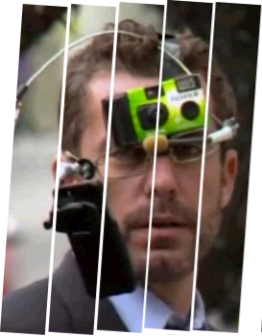
Welcome back!
How was the experience?
PROTOTYPE
Commit to 2 prototypes this month
Radical collaboration to keep you accountable, schedule a check-in?
Notes:
Think for a minute, which 2 prototypes will you commit to this month? And do you want to find a buddy? After the session, reach out to someone you worked with today, and perhaps schedule a check in in 1 month to experience radical collaboration as well.

Slide 46
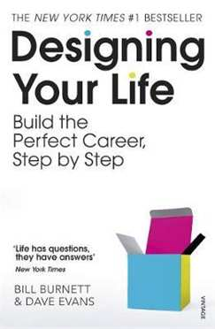
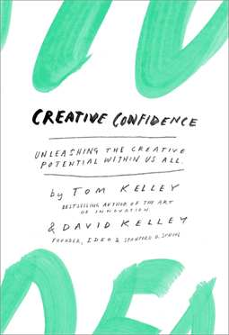
Extra bonus for the book-worms
Notes:
And this is all for today, I hope you enjoyed the session. I just want to leave you with some books if you are curious to know more.
Let´s go into Q&A everybody

Slide 47
Q&A_Mapping the Private Sector
TERESA CALLEJO
ROSA YLIMAULA
UNOG

Slide 48
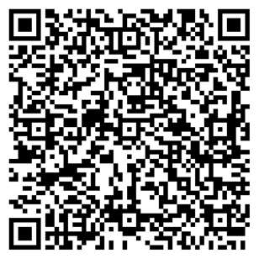
Survey Form
Let us know your thoughts about the session!​
👉 Click here or scan the QR code.

Slide 49
Coming up tomorrow:
CAREER TRANSITION READINESS PROGRAMME
DAY 1. MAPPING THE PRIVATE SECTOR
DAY 2. DESIGN THINKING YOUR CAREER
DAY 3. JOB SEARCH STRATEGY
DAY 4. APPLICATION MATERIALS
DAY 5. COMPENSATION

Slide 50

Thanks for your participation!
Notes:
In light of the evolving organizational landscape across the UN system, building on the UN80 reform agenda’s emphasis on transformation and collaboration, UN Geneva, UNDP, UNHCR and IOM have launched the Career Transition Series: Pivoting Outside the UN System.
This inter-agency initiative responds to the growing need for practical career transition support, helping UN personnel navigate change and explore professional opportunities in the private and non-UN sectors.
Beyond the UN: Global Career Opportunities
Exploring Professional Pathways Beyond the UN System
An inter-agency career transition initiative
Jointly led by IOM, UNOG / UN Secretariat, UNDP, UNHCR and WHO
With technical and operational support from Global Careers
In light of the evolving organizational landscape across the UN system, building on the UN80 reform agenda’s emphasis on transformation and collaboration, IOM, UN Geneva, UN Secretariat in New York, UNDP and UNHCR are launching the Career Transition Series: Pivoting Outside the UN System. This inter-agency initiative responds to the growing need for practical career transition support, helping UN personnel navigate change and explore professional opportunities in the private and non-UN sectors.
Whether you are directly affected or proactively planning your next steps, this series will provide you with practical tools, expert insights, and the confidence to successfully pivot in today's evolving job market.

